Slide 1
Tobacco Prevention, Vape Prevention, & Cessation
Kati Moore, MPH, GCEPID
Mindy Curran, MPH
1/19/23
excellence | Positive impact | Partnership | innovation | credibility | Humanity

Slide 2
Agenda
Cessation vs prevention
Discuss tobacco prevention, vape prevention, and smoking cessation objectives that Central District Health has for improving community health
Propose tobacco prevention, vape prevention, and cessation programs to promote that aid Elmore County Health Coalition’s Action Plan

Slide 3
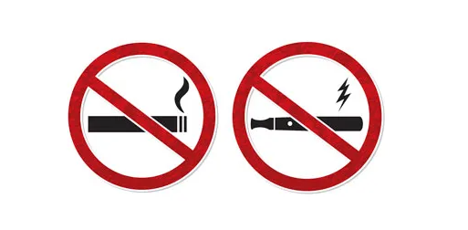
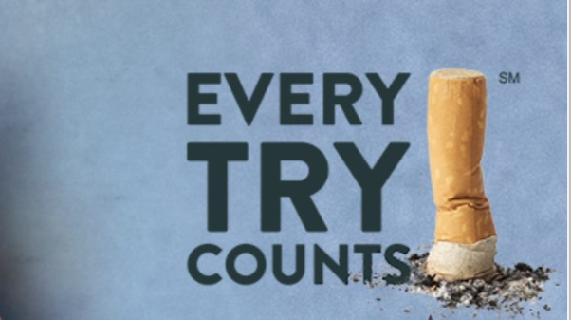
Cessation vs. Prevention
Cessation: The process of being ended. Tobacco/nicotine cessation can only be carried out if someone has already participated in the behavior.
Prevention: The action of hindering an event or behavior from occurring. Tobacco/nicotine prevention is anticipating that smoking behavior can occur and acting to deter it from ever occurring.

Slide 4
Building Healthier Communities
Preventing initiation of tobacco use
Promoting tobacco cessation among adults and youth
Eliminating secondary and tertiary exposure to environmental tobacco smoke
Identifying and eliminating tobacco-related disparities

Slide 5
Objective 1: Decrease substances used in Elmore County Objective 2: Promote awareness of at least 3 underutilized substance use prevention/rehabilitation programs in Elmore County
Cessation
Conduct inventory of tobacco/nicotine/vaping cessation programs currently being offered in Elmore County
Run a tobacco/nicotine/vaping cessation campaign within Elmore County
Prevention
Promote tobacco/nicotine/vaping prevention programs in schools and the community
Both
Partner to recognize, promote, and expand vaping/smoking related awareness months/events

Slide 6
What We Know About Disparity
Tobacco companies target certain groups of people through marketing

Slide 7
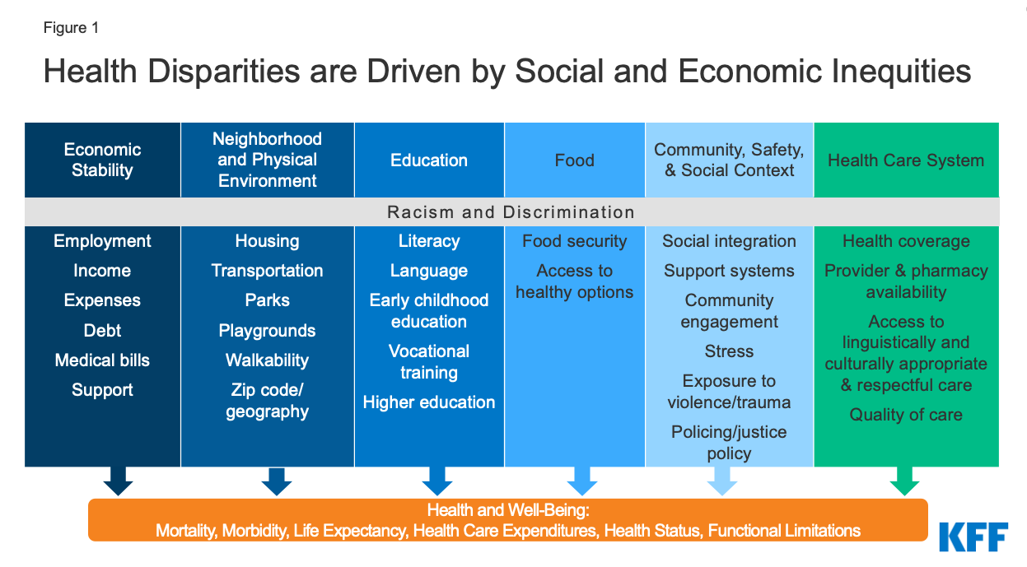
What We Know About Disparity
The pressure of discrimination, poverty, and other social conditions can increase tobacco use and make health problems worse
Barriers to health care and treatment for tobacco use and dependence

Slide 8
Commercial Tobacco and Population Groups
Behavioral health conditions and substance use disorders
Low socioeconomic status
Uninsured- 27.3%
Medicaid- 28.6%
Public insurance- 21.3%
Private insurance- 16.4%
Medicare- 12.5%
Living in some geographic areas- primarily rural communities

Slide 9
Preventing Initiation
22.8% Idaho high school youth reported using any tobacco product, including e-cigarettes.
Among those, 5.3% reported smoking cigarettes.
CATCH my breath: youth vaping prevention
Parents Against Vaping E-Cigarettes (PAVe)
My Life My Quit by Project Filter

Slide 10
Methods to Prevent Tobacco
Community-led public service announcements (PSA)
Collaboration with health professionals
Creation of tobacco and vape-free policies

Slide 11
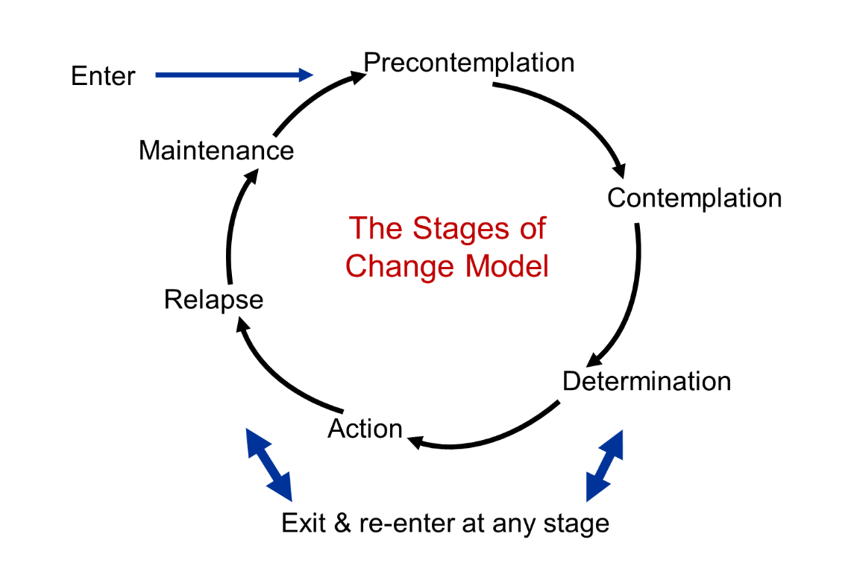
Transtheoretical Model

Slide 12
Cessation Programs
Kick! Your Cravings- In-person or FREE cessation classes for teens or adults
Free phone & web-based quitting help through Project Filter
Free nicotine patches, gum, or lozenges- 8 weeks FREE from Idaho Quitline, 2 weeks FREE from CDH
Diaper Incentive Program- Incentivizes new or pregnant moms to quit using nicotine with FREE diapers and wipes. Mountain Home CDH office is already implementing.
3rd Millennium- Online, module-based program. Can be used as a prevention or intervention technique.
Others in the community?

Slide 13
Do you have any questions?
Kmoore@cdh.idaho.gov, Mcurran@cdh.idaho.gov
www.cdh.idaho.gov
Kati: 208-954-7094
Mindy: 208-327-8547

