Slide 1
ID-AWARE Project
School-Based Mental Health

Slide 2
Project Advancing Wellness and Resiliency in Education (AWARE)
Purpose:
To build or expand the capacity of State Education and Mental Health Agencies, related to overseeing school-aged youth programs and services, within three local education agencies, to:
Increase awareness of mental health issues among school-aged youth;
Provide training for school personnel and other adults who interact with school-aged youth to detect and respond to mental health issues; and
Connect school-aged youth and their families, who may have behavioral health issues, to needed services.
Notes:
Explain AWARE acronym. Explain SAMHSA’s purpose of this grant.
AWARE is a unique grant opportunity because it works to combine two state entities in the work. Thus, the grant has been awarded to the State Department of Education but our Project is also co-coordinated by representatives from DHW. So, really, we are working to connect state agencies from the education and mental health sectors.
Here are our overarching goals for SAMHSA.
Raise awareness about mental health issues among school-aged youth
Provide education and training to school personnel and other adults (parents/caregivers/community members) about how to effectively detect and respond to mental health issues.
Finally, provide accessible behavioral health services to students and their families.

Slide 3
AWARE Funding and Management
Five-year grant awarded to the State Department of Education
Project AWARE is a federal grant funded by the Substance Abuse and Mental Health Administration’s (SAMHSA) Center for Mental Health Services (CMHS)
In September of 2020, the Idaho State Department of Education (SDE) was awarded Project AWARE. Totaling $5.8 million dollars over five years.
The SDE contracted the management of this project out to the Idaho Lives Project, which is a program of the SDE under the division of Student Safety and Engagement.
The project is co-coordinated by a representative from the Idaho Department of Health and Welfare - Division of Behavioral Health.
Notes:
Explain logistics about Idaho AWARE.
Explain that this is federally funded and a 5- year grant
Explain that the grant recipient is the SDE.
Explain state agency representation in coordination and administration of the Project.
SDE/ILP
DHW/DBH

Slide 4
A Comprehensive System of School Mental Health Supports
Notes:
Katie

Slide 5
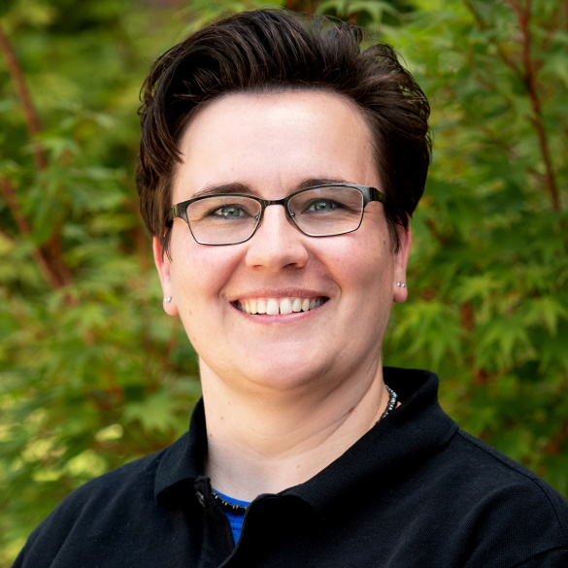
ID-AWARE Project Advisory Board
Susan Barrett, MA
Director of the Center on Social Behavior Supports
Old Dominion University
Kelcey Schmitz, MSEd
MTSS/School Mental Health Training and TA Specialist
University of Washington, SMART Center
Dennis Woody, PhD
Pediatric Neuropsychologist, Senior Clinical Program Consultant
Optum
Anna Almerico
Director
Idaho Out-of-School Network
Jackie Yarbrough, MPA, LSW
Senior Program Officer Blue Cross of Idaho Foundation for Health
Julie Mead, EdS
Director of Operations, Idaho Special Education Support and Technical Assistance (SESTA)
Boise State University- Center for School and Community Partnerships (CSPS)
Notes:
While we have representatives at the state-level guiding this work, we also have an outstanding advisory board that helps guide us and support our efforts. Several members are at the state/local level and a couple are from the national/regional level. Explain that we have representation from schools, PBIS/multi-tiered systems of supports, and mental health.

Slide 6
ID-AWARE Goals
Capacity
Evidence-based Interventions
Data Tracking Systems
Increase the capacity of the LEAs to work preventatively, identifying and supporting students earlier before issues escalate
Link students’ needs to appropriate evidence-based interventions
Create and sustain data tracking systems to ensure youth receiving intervention are showing improvement
Clinicians
Healthier School Environments
Expand the work of clinicians to support students and their families across all tiers of support
Assist in creating healthier school environments
Notes:
Because this is the first award for Idaho, our efforts are being focused at a local level, with the hopes that eventually we can expand efforts, frameworks, services/resources statewide. At the local level, these are our goals for the three LEAs (local education agencies). Explain our rural component to ensure efforts are scaleable statewide
Explain the following
Capacity: We want to build each LEAs capacity to be able to offer support when interventions are needed but also help them focus on preventative efforts. To build and strengthen capacity at the district/school/student-level.
Evidence-Based Interventions: We want to ensure that we not only have evidence based interventions and services in place and accessible but also that students are being directed to appropriate interventions to begin with. So builiding up the training of staff and adults to know how, when, where, and who to refer students to.
Data Tracking Systems: Through out data tracking systems, we want to ensure that everything on paper works in real life, and when it doesn’t work out we can pivot to ensure better outcomes, as well as when things do work out we can accentuate on those points and apply them to other situations.
Clinicians: This really comes down to ensuring that we provide access to clinical-level behavioral health services. And truly access to care is multifaceted, we want to ensure it is affordable, geographically located, and clinicians are competent in various modalities and backgrounds to meet student/family needs.
Healthier School Environments: We have no doubt that the LEAs we are working with already have healthy school environments. However, our goal is to assist schools in constantly improving and the the other elements described previously will ultimately help us attain this final goal.

Slide 7
Idaho Landscape
Rural and frontier communities experience gaps in services, and schools often struggle to maintain programs and infrastructure to fill these gaps
Residents travel greater distances to receive services.
Communities tend to have lower socioeconomic status, higher poverty rates, may lack comprehensive health care coverage, and experience a shortage of qualified mental health providers.3
In the schools, student-to-counselor ratio averages 400 to 1, which may reduce a school’s ability to intervene, which can exacerbate mental health crise and sometimes require hospitalization.4
Table: U.S. Census Bureau, Population Division. (2017). Annual Estimates of the Resident Population for the United States, Regions, States, and Peurto Rico. Retrieved from https://www.census.gov/data/tables/2017/demo/popest/state-total.html, 3. Institute of Medicine (US) Roundtable on Environmental Health Sciences, Research, and Medicine; Merchant J, Coussens C, Gilbert D, editors. (2006). Rebuilding the Unity of Health and the Environment in Rural America: Workshop Summary. Washington (DC): National Academies Press. The Social Environment in Rural America. Retrieved from: https://www.ncbi.nlm.nih.gov/books/NBK56967/, 4. National Center for Education Statistics. (2020). Education Demographics and Geographic Estimates. Retrieved from https://nces.ed.gov/programs/edge/Home
Notes:
Explain that we wanted to focus on rural, because a lot of Idaho consists of rural counties/areas and they face more barriers to accessing care. You can touch on a couple of points, but just share that this helped inform our decision for focus on serving rural or frontier areas.

Slide 8
Local Landscape
At the local level, districts have shared limitations they face.
Experience with integrating mental health in schools
Limited Capacity of the Provider: Services can end abruptly, if communities are under-resourced and a larger community need arises.
Lacking Infrastructure: Services may be in place, but comprehensive integration isn’t being attained and systems/disciplines aren’t communicating cohesively.
No experience integrating mental health in schools
Increased Strain on Community Services: Referring students out to community services can actually increase strain on already burdened community agencies and systems.
This is a systems issue, not a school issue.
Idaho AWARE’s goal is to educate school staff and adults about mental health prevention and intervention methods, while simultaneously providing sustainable services to fill immediate needs. Ultimately, the hope is to reduce strain on community services and resources, and eventually advance movement towards prevention-based services and care rather than intervention.
Notes:
Share that this consists of information from each of the school districts we have partnered with. Some had experience integrating behavioral health, while others didn’t at all or did not successfully. Highlight that bottom content, that it isn’t a school issue but a systems issue, and how AWARE proposes to help or positively impact the system.

Slide 9
Participating School Districts (LEAS)
Kimberly School District
~ Glenns Ferry School District ~
Notes:
Ali
These are our three LEAs

Slide 10
Student Behavioral Health Services Evaluation Report
Out of 410 respondents, over half (57%) of respondents were from rural school districts.
Findings:
District-level guiding framework for behavioral health and wellness services (BHWS): 15 percent of administrators at rural districts said they had no specific guiding framework for BHWS compared with 9 percent of administrators at non-rural districts.
District-level implementation of BHWS approaches and support: Rural respondents were 19 percent points more likely to report that their district didn’t have specific district-level policies for implementing BHWS and 17 percentage points more likely to report that their district didn’t provide professional development.
School-level implementation of BHWS approaches and support: Rural school administrators, used outside service providers 18 percentage points more often than non-rural school administrators, and said that BHWS was a part of their school mission or strategic plan 11 percentage points less often than non-rural school administrators.
School staff preparation to teach BHWS: Overall, 13 percent of school administrators in rural districts reported not currently preparing employees to deliver BHWS compared with 5 percent of school administrators in non-rural districts.
Student Behavioral Health Services Evaluation Report. (2021). Idaho State Department of Education Student Engagement and Safety Coordination. Retrieved from: http://idahoschoolmentalhealth.org/Portals/76/Documents/Resources/ismh-resources-behavioral-health-evaluation.pdf
Notes:
Ali
Report from the SDE

Slide 11
Student Behavioral Health Services Evaluation Report Cont.
Findings: Barriers at the District-Level
Lack of time (83 percent)
Limited funding for resources (78 percent)
Limited funding for programs and services (76 percent)
Limited funding for professional development (58 percent).
One finding that was notably different for rural administrators was location, which was identified as a barrier by 47 percent of rural school and district administrators and only 14 percent of nonrural school and district administrators.
Student Behavioral Health Services Evaluation Report. (2021). Idaho State Department of Education Student Engagement and Safety Coordination. Retrieved from: http://idahoschoolmentalhealth.org/Portals/76/Documents/Resources/ismh-resources-behavioral-health-evaluation.pdf
Notes:
Ali

Slide 12
ID-AWARE LEA Support Elements
Notes:
This is an overview of what elements of support are in place for each LEA. Briefly explain each support. Share that these are the pillars to what we offer and that they will be explained in more depth.

Slide 13
Professional Development
Year 1 | Year 2 | Year 3 | Year 4 | Year 5
Statewide Leadership Institute Statewide Coaching Institute SWIS Facilitator Training Statewide PBIS Tier 1 Team Training Institute Suicide Prevention Fundamentals Instructions | State Advanced Coaching Institute Trauma-Sensitive Classroom Practices CICO-SWIS Facilitator Training Statewide PBIS Tier 2 Team Training Institute Sources of Strength (at the Elementary and Secondary levels) | Support for Students Exposed to Trauma (SSET) I-SWIS Facilitator Training Statewide PBIS Tier 3 Team Training Institute | PART I: Statewide Interconnected Systems Framework (ISF) Team Training Institute Cognitive Behavioral Interventions for Trauma in Schools (CBITS) and Bounce Back (BB) PART II: Statewide Interconnected Systems Framework (ISF) Team Training Institute | PART III: Statewide Interconnected Systems Framework (ISF) Team Training Institute Youth Mental Health First Aid
Notes:
Explain that this is our five-year plan for LEA professional development. Mention that we wanted to have a plan for our grant and this is one of the driving factors, we didn’t want to build the airplane in mid-air, but note that some things have shifted.
Explain how each year’s PD builds upon knowledge each year (Tier One=Year One, Tier Two=Year Two, etc).

Slide 14
The Power of Teams
Notes:
Explain Teams and the impact. You can simply share that research suggests that information is understood, retained, and utilized more effectively when experienced in teams, rather than solely by ones self. This is just data that supports this notion, and because of this it has guided how we have established team to onboard new programs and frameworks, specific to AWARE.

Slide 15
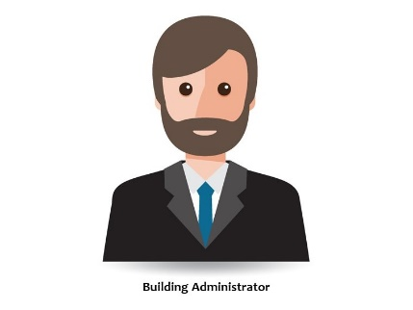
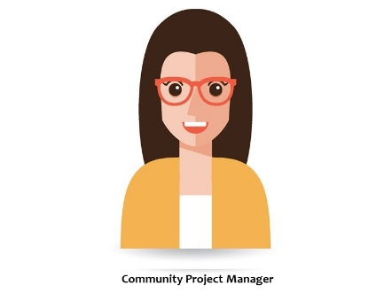
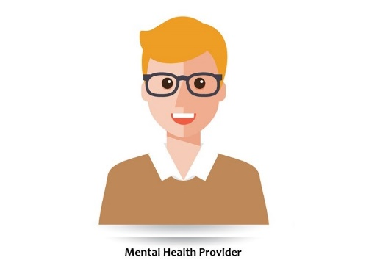
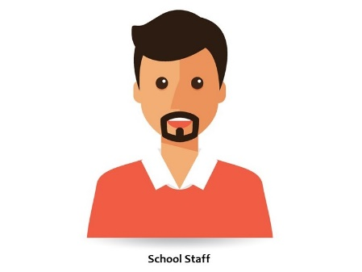
ID-AWARE Project Teams
Executive Leadership Team
School Leadership Team
(Team of 3-5 individuals)
(Team of 3-5 individuals)
Notes:
Explain the organization of our AWARE teams. This is specific to PBIS. Share each district has an executive leadership team and then each school building has a school leadership team and these are how the teams are organized or structured.

Slide 16
ID-AWARE Specific Leadership Team Members
Notes:
Explain that these are two key roles that help implement all aspects of the grant.
The Community Project Manager is a school district employee that acts as a liaison from the local level (school level) to the state level (Project level). This individual works closely with AWARE staff to plan things at the district level, as well as provides the Project insights about needs.
The Schoolwide Team Coach is a PBIS-specific role. This individual is the PBIS coach for their school. Each building has a Coach and this individual helps trained and non-trained staff about PBIS implementation, interventions, and maintenance.

Slide 17
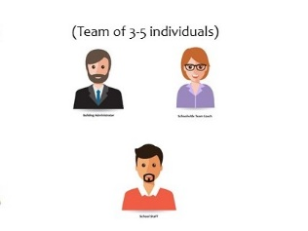
Statewide Leadership Institute
Format: 1-day professional development session
Purpose: Introduction and overview of ID-AWARE Project
Participants:
Professional Development
Statewide Coaching Institute
Format: 2-day professional development session
Purpose: Increase the participants’ capacity to influence reflective practices and problem-solving strategies through the use of coaching.
Participants:
YEAR 1
(October 2020 – September 2021)
SWIS Facilitator Training
Format: 2.5-day professional development session
Purpose: Build capacity to collect, analyze, and utilize data to make data informed decisions
Participants:
Suicide Prevention Fundamentals Instruction
Format: 2.5-hour professional development session
Purpose: Increase knowledge and skills in relation to suicide prevention
Participants: All staff
Statewide PBIS Tier 1 Team Training Institute
Format: 4-day professional development session
Purpose: Guide participating schools to create proactive systems of behavior instruction and management
Participants: School Leadership Team
Notes:
Katie

Slide 18
Sources of Strength Secondary
Format: 2-day training
Purpose: Train Adult Advisors and Peer Leaders in identifying students at-risk of suicide and getting them help, as well as create positive messaging campaigns related to seeking help and connecting with positive/trusted adults.
Participants: 5-10 staff members and 30-45 students, per school.
Sources of Strength Elementary
Format: 2-day training
Purpose: Train elementary staff in how to facilitate curriculum for 3rd-5th/6th grade classrooms. Sources of Strength Elementary™ is not only focused on recognizing warning signs and intervening, but their mission is to discover, teach and celebrate resilience, help-seeking, strength, connection, and belonging.
Participants: 2-3 staff elementary members, per school.
Professional Development
Statewide Advance Coaching Institute
Format: 1-day professional development session
Purpose: Increase the participants’ capacity to influence reflective practices and problem-solving strategies through the use of coaching.
Participants:
YEAR 2
(September 2021 – September 2022)
Statewide PBIS Tier 2 Team Training Institute
Format: 3-day professional development session
Purpose: Support school teams in maintaining their Tier 1 SWPBIS framework while creating a Tier 2 behavioral system
Participants: School Leadership Team
Trauma-Sensitive Classroom Practices
Format: 1-day professional development session
Purpose: Increase knowledge and skills in relation to trauma-sensitive practices. Our goal is to better understand, recognize, and respond to the effects of trauma our students have experienced.
Participants: All staff
CICO-SWIS Facilitator Training
Format: 2.5-day professional development session
Purpose: Build capacity to collect, analyze, and utilize data to make data informed decisions
Participants:
Notes:
Explain that this just shows who attends the trainings. Not everyone will attend every training.

Slide 19
On-site Technical Assistance
Format: One TA visit per month per LEA
Objective: Assist LEAs and schools in the implementation process. Coaching and TA are tailored to meet the specific needs of coaches, schools, and district to support initial adoption through sustained implementation of evidence-based practices.
Notes:
Feel free to read the objective
Our goal is to provide our districts as much assistance and help as possible, so we have built in technical assistance. However, we also offer assistance outside of these structured times.

Slide 20
Community Outreach Events
Objective: Educate the surrounding community in each identified LEA, in schools’ behavior framework, mental health awareness strategies, and suicide prevention strategies. In addition to understanding mental health and suicide prevention, ensure community members know where to access assistance for an emotional crisis or mental health need.
Notes:
Share that we have tasked our schools with completing/hosting a community outreach event each year, with the expectation that schools are sharing out about the Project and the work happening within the school. Additionally, we ask that each school includes some type of training component to raise adult awareness and educate them about ways to intervene, when a youth they are interfacing with experiences a mental/behavioral/emotional health crisis.

Slide 21
Implementation Evaluations and Data Collection/Analysis
Objective: Ongoing evaluation and assessment of implementation process to guide the application of evidence-based practices
Notes:
Each district is developing a data evaluation and analysis process, so that it can help guide how schools intervene. Our goal is to help them make informed, dada-driven decisions.

Slide 22
On-site Clinician
ID-AWARE Project is embedding a full-time licensed clinician into your district, which will:
Reduce the burden on school counselors
Bolster support by encouraging students and their families to visit your on-site clinician for emotional or mental health crisis
Objective: Increase access to mental health services and reduce stigma associated with seeking help. As an extension of your support staff, the on-site clinician will:
Participate in student meetings, as well as district trainings and meetings
Be accessible to students, staff, and families (we encourage you to consider a central location)
Notes:
Explain that our intent is to build in sustainability. So, AWARE has contracted with mental health agencies and not individual clinicians for capacity reasons. Agencies can also ensure that more services can be covered by multiple insurance agencies. For example, agencies are more likely to serve Medicaid clients than an individual clinician can.
Explain that clinicians work off billable hour and will provide services to uninsured/underinsured students/families. For this population, AWARE pays for the clinician’s time. AWARE also pays the clinician to be fully embedded, so we want to ensure that this clinical expertise is shared at the executive team level and they are involved in other school-based meetings, directly related to their position.

Slide 23
LEA Stipend
This stipend will cover all project expenses (i.e., implementation materials, substitutes, travel, stipends, etc.)
Resources
Conference Registration
Opportunities to attend conferences at the state and national levels
Statewide School Mental Health Website
Objective: The creation of the ID-AWARE Online Information Portal will assist LEAs in their implementation of PBIS, as well as solidifying their ISF. The Information Portal will also help to scale up and to create sustainability of these efforts, as LEAs around the state will have access to, but not limited to, the following: professional development training materials, instructional videos, local examples of PBIS and ISF implementation, domain to network with other educators and mental health providers throughout the state and beyond.
www.idahoschoolmentalhealth.org
Notes:
Explain that these are our multi-prongs resources
Share that each LEA receives a stipend to help implement and maintain the Project’s efforts.
We also offer free conference registrations to various mental health or PBIS-related conferences locally and nationally.
And as a statewide/national resource, we have created the Idaho School Mental Health Website. This acts to provide individuals, families, schools, clinicians with a variety of resources related to school mental health. Encourage individuals to visit our site and provide additional resources to our resource page.

Slide 24
The Clinician’s Role
Current, qualified licensure
Participate as a member of the Executive school team
Provide staff and personnel with consultation services
Provide individual, family, or group counseling to students and their families, in person
Provide referrals to students, families, and staff. As well as track access to services from those referrals
Master's level
Participate in all AWARE and school-based training opportunities
Billing: bill based on private and public insurance fee schedules. If not billable, invoice Project AWARE
If not clinically licensed, must receive supervision.
Notes:
Explain that this is what we envision the clinician’s role to be. Briefly run through each piece.

Slide 25
Idaho AWARE Resources for Clinician Integration
Process for Identifying and Selecting a Mental Health Agency/Clinician
Mental Health Agency Interview Questions
Scope of Work Examples
Mental Health Agency
Clinician
Parental Consents for Data Collection
Budget Plan Examples for Embedding Clinicians
Idaho School Mental Health Portal
Healthy Minds Partnership Roadmap
Notes:
Explain that these are free resources we have developed and are offering to other schools or mental health organizations looking to become involved in school-based therapy.

Slide 26
Clinician Scope of Work
Maintain a current, qualifying license to practice counseling in Idaho.
Adhere to professional behaviors that reflect respect for all individuals and high level of cultural sensitivity while working with diverse communities, including vulnerable populations.
Abide by policies and procedures with respect to confidentiality and student educational records, per FERPA guidelines.
Abide by policies and procedures with respect to confidentiality of public health information and clinical data, per HIPAA guidelines.
Participate in trainings and educational opportunities specific to school-located behavioral health care at the community-level, state-level, and national-level, secondary to providing direct practice services. Clinicians can submit up to three days, annually, of professional development training.
Attend all trainings and institutes specific to Project AWARE programming and reporting. This includes but is not limited to; PBIS Tier Two Institute, Trauma Informed Practices, and NOMs collection.
Participate in school/district orientation, trainings, and meetings to familiarize oneself with the district’s cultural and approaches associated with managing behavioral problems and fostering a positive school climate.
Participate and contribute to the development and maintenance of the Project AWARE executive team and/or school leadership team.
Work collaboratively with school nurses, principals other school staff (School Social Worker, Counselor, Parent Liaison, etc.) and teachers on cases that require follow up of urgent issues.
Participate as member of the school mental health team.
Attend and/or remain available for consultation at various school/district meetings, as needed. These include but are not limited to; staff meetings, 504 and/or IEP meetings, and interdisciplinary meetings.
Attend and participate in monthly AWARE Clinician Meetings, as time allows.
Provide consultation services and support to school and district staff/personnel.
Accept service referrals from school or district staff/personnel for assessment, treatment planning, and ongoing counseling/skill building services, to be provided to students and their families.
Provide services/consultations primarily in-person from district-designated office space. The clinician shall remain available to staff, students, and their families on-site, during school hours. If the clinician is quarantined or the school district transitions to online learning, the clinician will provide services/consultations via telehealth therapy from a confidential space at home or at the mental health agency, if able. Services may also be provided at the mental health agency location or the home of a student and/or their family, if necessary and evidenced that this would benefit student wellbeing and treatment/service participation and outcomes.

Slide 27
Clinician Scope of Work Cont.
Seek parental consent prior to offering any care or services, as necessary.
Provide a variety of evidence-based or evidence-informed practices, interventions, and therapies to students and their families in need of short-term or long-term clinical support, including trauma-informed care services.
Provide crisis support to students and their families if consent is obtained. If consent is not obtained, provide consultation to staff in crisis intervention situations.
Provide individual, group, and/or family therapy to students and their families. Before providing group therapy, clinicians must review the Idaho AWARE Group Therapy Protocols to ensure requirements of the grant are being met and meet billing requirements.
Provide care to all students and their families that present to care, regardless of inability to pay.
Bill provided services under the appropriate private or public health insurance identified by the student and their family. If student is uninsured or underinsured, the clinician or the mental health agency shall submit an invoice and summary of work for services performed, to the SDE as outlined below in the payment section. Clinicians will be compensated by the grant for non-billable hour work, including mandatory Idaho AWARE education and meetings.
Develop a schedule or organized process for scheduling sessions with students and their families, which ensures that sessions will rotate among class periods and reduce the potential of a student missing the same class and falling behind academically.
Create, maintain, and evaluate treatment plans.
Complete or assist with intake, reassessment, and discharge interviews as designated by Project AWARE staff, and share with AWARE key personnel to input into SAMHSA’s SPARS system.
Document sessions and track progress of students and their families, using a password protected documentation system, utilized by the mental health agency.
Build a repository of community behavioral health and medical resources.
Provide behavioral health or medical referrals to students and their families in need of services, as appropriate.
Work collaboratively with external agencies and groups that would benefit the child and family.

Slide 28
Mental Health Agency Scope of Work
Work in partnership with _______ School District(s) to identify, support, and develop behavioral health services.
Provide, at minimum, 1.0 FTE clinician per service location to deliver services within ______ School District(s) that meet Project AWARE’s grant requirements and fulfill the scope of work as listed below (Clinician Scope of Work). As needed, the Contractor may provide more than 1.0 FTE clinician, with approval from the Project Coordinator and Co-Coordinator. Professionals must be licensed as a Master level behavioral health clinician, by an accredited national certification association or board.
Provide clinical management and/or supervision of clinician(s) to assure compliance with the agreement and Project AWARE requirements. Supervisors must be a licensed clinical provider (LCSW, LCPC, or PHD).
Provide supportive and/or supplemental services and resources as necessary to improve access and ensure efficacy of services. This can range from providing additional clinician(s), supplemental clinical services (i.e., Clinician specialized in a specific modality not offered by the full-time clinician), language translation services, and other services not specifically identified. If a service is not specifically identified, it must be approved by the Project Coordinator and Co-Coordinator.
If supplemental or supportive services are being provided by agency staff or contractors, aside from the full-time clinician, services may be rendered at the school, the students/family’s home, or the mental health agency. These services may only be provided as necessary with evidence supporting, the benefit on student wellbeing and treatment/service participation and outcomes.
Perform criminal background investigations on clinicians preparing to work within _______ School District(s), prior to placement.
Ensure clinician(s) and their services are covered by a general liability/malpractice insurance policy.
Provide telehealth platform for clinician to use, should they be quarantined, or the school district transitions to online learning.
Provide clinician access to documentation system utilized by the mental health agency to store and retain electronic records.
Ensure appropriate and acceptable accounting and billing services or protocols are in place. The clinician will bill appropriate private or public health insurances when a student/client is seen. If the student/client is uninsured, underinsured, or the clinician completes work that is not billable an invoice and summary of work will be submitted to the SDE for compensation of these hours, as outlined in the terms of payment section.
Shall provide the clinician with a computer to complete documentation, scheduling, and other day-to-day tasks.
Follow board approved policies and procedures that adhere to HRSA guidelines, as standards of clinical practice and accredited through regulating agencies including JCAHO and HRSA.
Develop required consents (consent for treatment, assurance of HIPAA/FERPA compliance, telehealth consent, and consent to bill insurance) for participation in the services, as necessary.
Comply with all federal and state laws prohibiting discrimination.
Comply with standards set forth in Title II of the Americans with Disabilities Act.

Slide 29
ID-AWARE Community Support Elements
Professional Development and Trainings
Community Collaborative Meetings
Parent Education and Support Groups
Stronger Together Conference
Notes:
Explain that while our main focus is on our school districts, we also wanted to dig a little deeper to ensure sustainability, so we built in community-based aspects and these are our elements of support offered.
Free conference registration for community members for PD and free training opportunities
Dr. Rudd- Arresting and Treating Suicidality for clinicians Various PBIS related conferences Idaho Prevention and Support Conference PREPaRE training
Community collaborative groups/meetings: explain that we are currently operating a meeting that brings together agencies and stakeholder to discuss ways to promote mental health and wellness in each community. Share that we are currently experiencing issues with getting the community to engage in this and wanted to reach out to see if the Elmore Health Coalition would be interested in letting up jump in on their meeting and offer more of a behavioral health approach. Share that we are just hoping to get on the agenda as a standing meeting item, to share our resources or pose a question to the group of what AWARE could look into offering.
Community support groups for parents/caregivers with children experiencing mental health concerns. Explain that this is being managed by a national organization called the Youth Mental Health Project, and we are hoping to stand up a group by December.
Superconference: share that this annual conference is something AWARE has partnered on with Idaho-based school counselor, psychologist, and social work associations. It seeks to provide education and awareness to school and community professionals and families about how to help youth.

Slide 30
Notes:
This is our team of schools and staff.

Slide 31
Contact Information
Ali Shields, LMSW
Idaho AWARE Project Coordinator
ashields@idaholives.org
Amy Balzer, LCSW
Idaho AWARE Project Co-Coordinator
Amy.balzer@dhw.Idaho.gov
Katie Azevedo, EdD
ID-AWARE Project Content Specialist
Katie@kazevedo.com,
https://www.kazevedo.com/
Kristina Cowan, LMSW
Idaho AWARE Service Coordinator
For more resources and information, visit our Idaho School Mental Health Website https://idahoschoolmentalhealth.org/
Notes:
Feel Free to add your headshot.

