Slide 1
Get Healthy Idaho Elmore Updates
Courtney Kelly, MPH
Project Coordinator
February 15th, 2023

Slide 2
Get Healthy Idaho – Elmore County
Collaborative grant between Elmore Health Coalition & WICHC
Grant Goal:
Address upstream causes of poor behavioral health and diabetes across Elmore County.
Grant Amount:
$155k for planning year
$235k each year for 3 years

Slide 3
GHI Timeline
Year 1
Sept 2020 – Sept 2021
Year 2
Oct 2021 – Sept 2022
Year 3
Oct 2022 – Sept 2023
Year 4
Oct 2023 – Sept 2024
We are here!

Slide 4
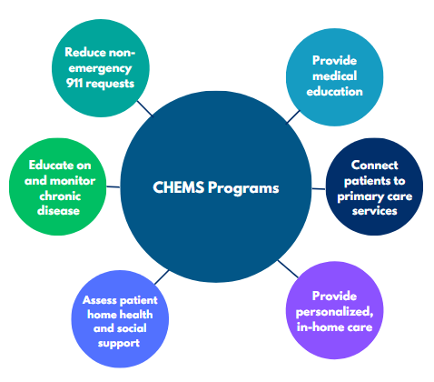
Community Healthy Emergency Medical Services (CHEMS)
CHEMS is a proven model that:
provides coordinated care.
helps fill gaps in healthcare systems.
addresses the root causes of preventable and non-emergency 911 calls.

Slide 5
Elmore Ambulance Service Community Paramedic
Dr. Jennifer Rhoads, Community Paramedic
PhD in Community Health
International Board Specialty Certification in Community Paramedicine (CP-C)
Nationally Registered EMT (NREMT)
National Registration for Initial and Diagnostic Cardiac Care (NRCEKG)
National Registration in Medical Assisting (RMA)
National Allied Health Instructor Certification (AHI)

Slide 6
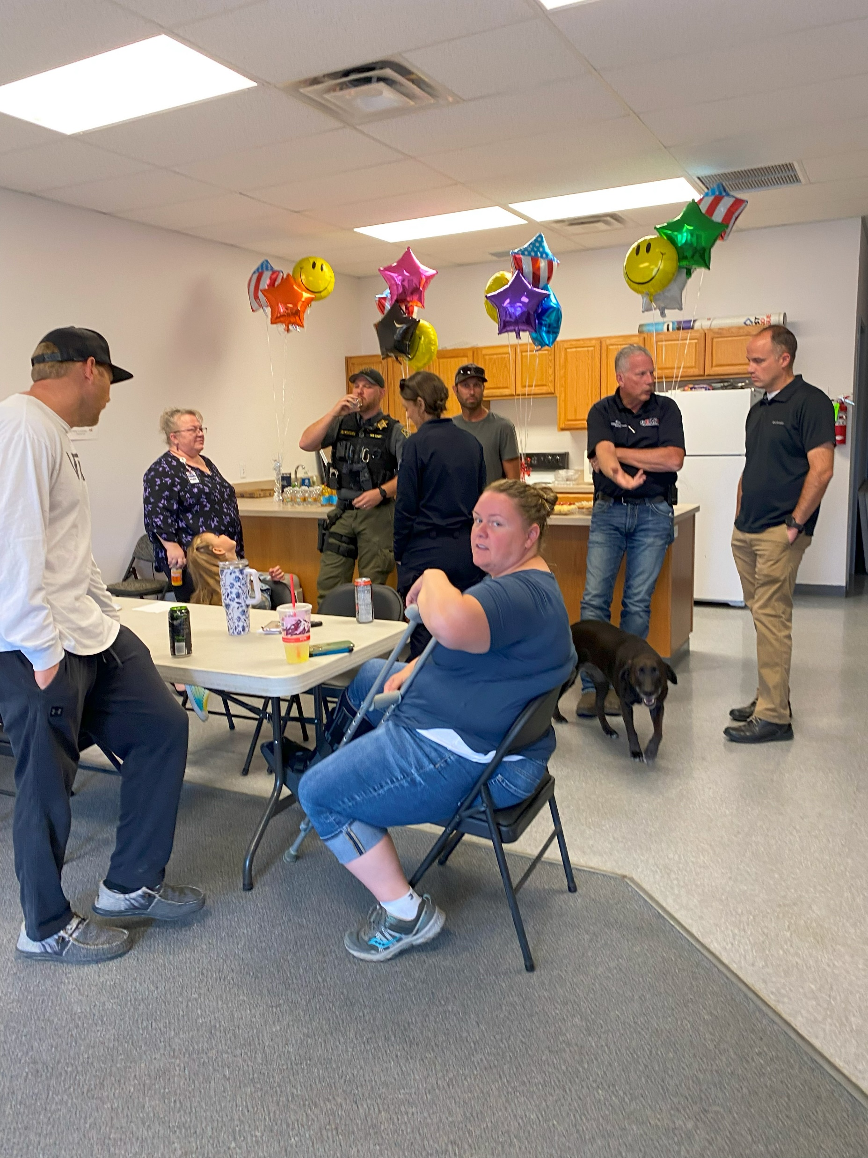
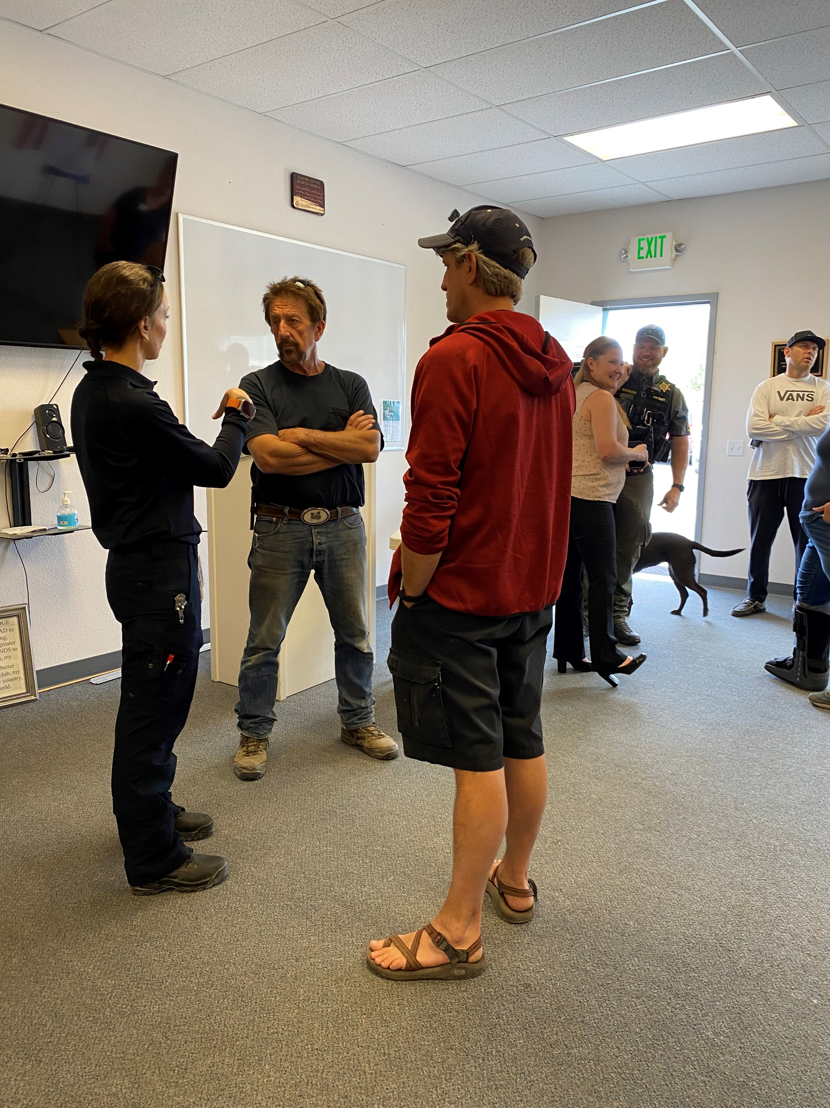
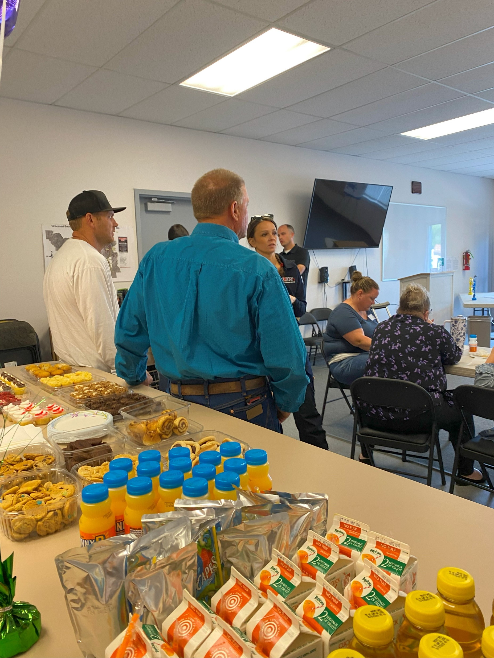
CHEMS Open House

Slide 7
CHEMS Operations
40 hours per week, split into Office Hours and Clinical Hours
Current patient total: 147
Diabetes management
High 911 utilization
Recent clinic discharge
Drug Court
So far, patients have been referred internally

Slide 8
CHEMS Contact
chems@elmorecounty.org

Slide 9
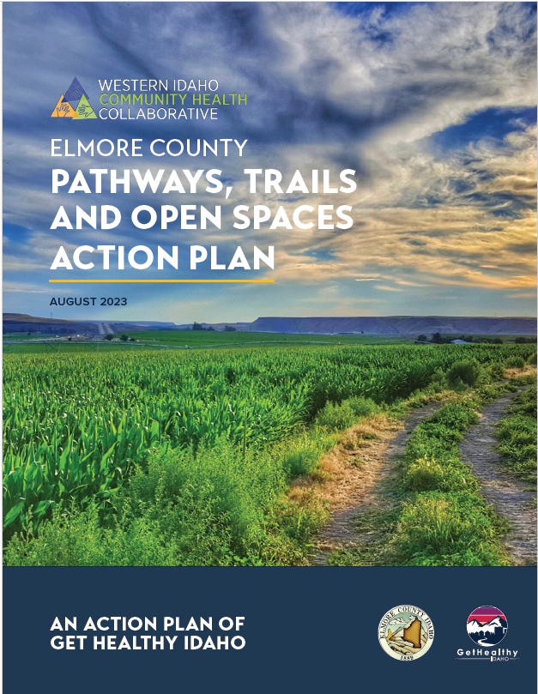
Elmore County Pathways, Trails and Open Spaces Action Plan
Support Elmore County in taking strategic action to increase and enhance its system of recreation
Focus on infrastructure to support positive physical and mental health outcomes for County residents
Thanks to Agnew::Beck and Alta Planning & Design

Slide 10
Action Plan Process Overview
PHASE 1: Visioning (2021)
PHASE 2: Action Plan (2023)
PHASE 3: Implementation Plan (2023-2024)
- Project prioritization
- Work plan development
PHASE 4: Ongoing Project Implementation (2024 and beyond)

Slide 11
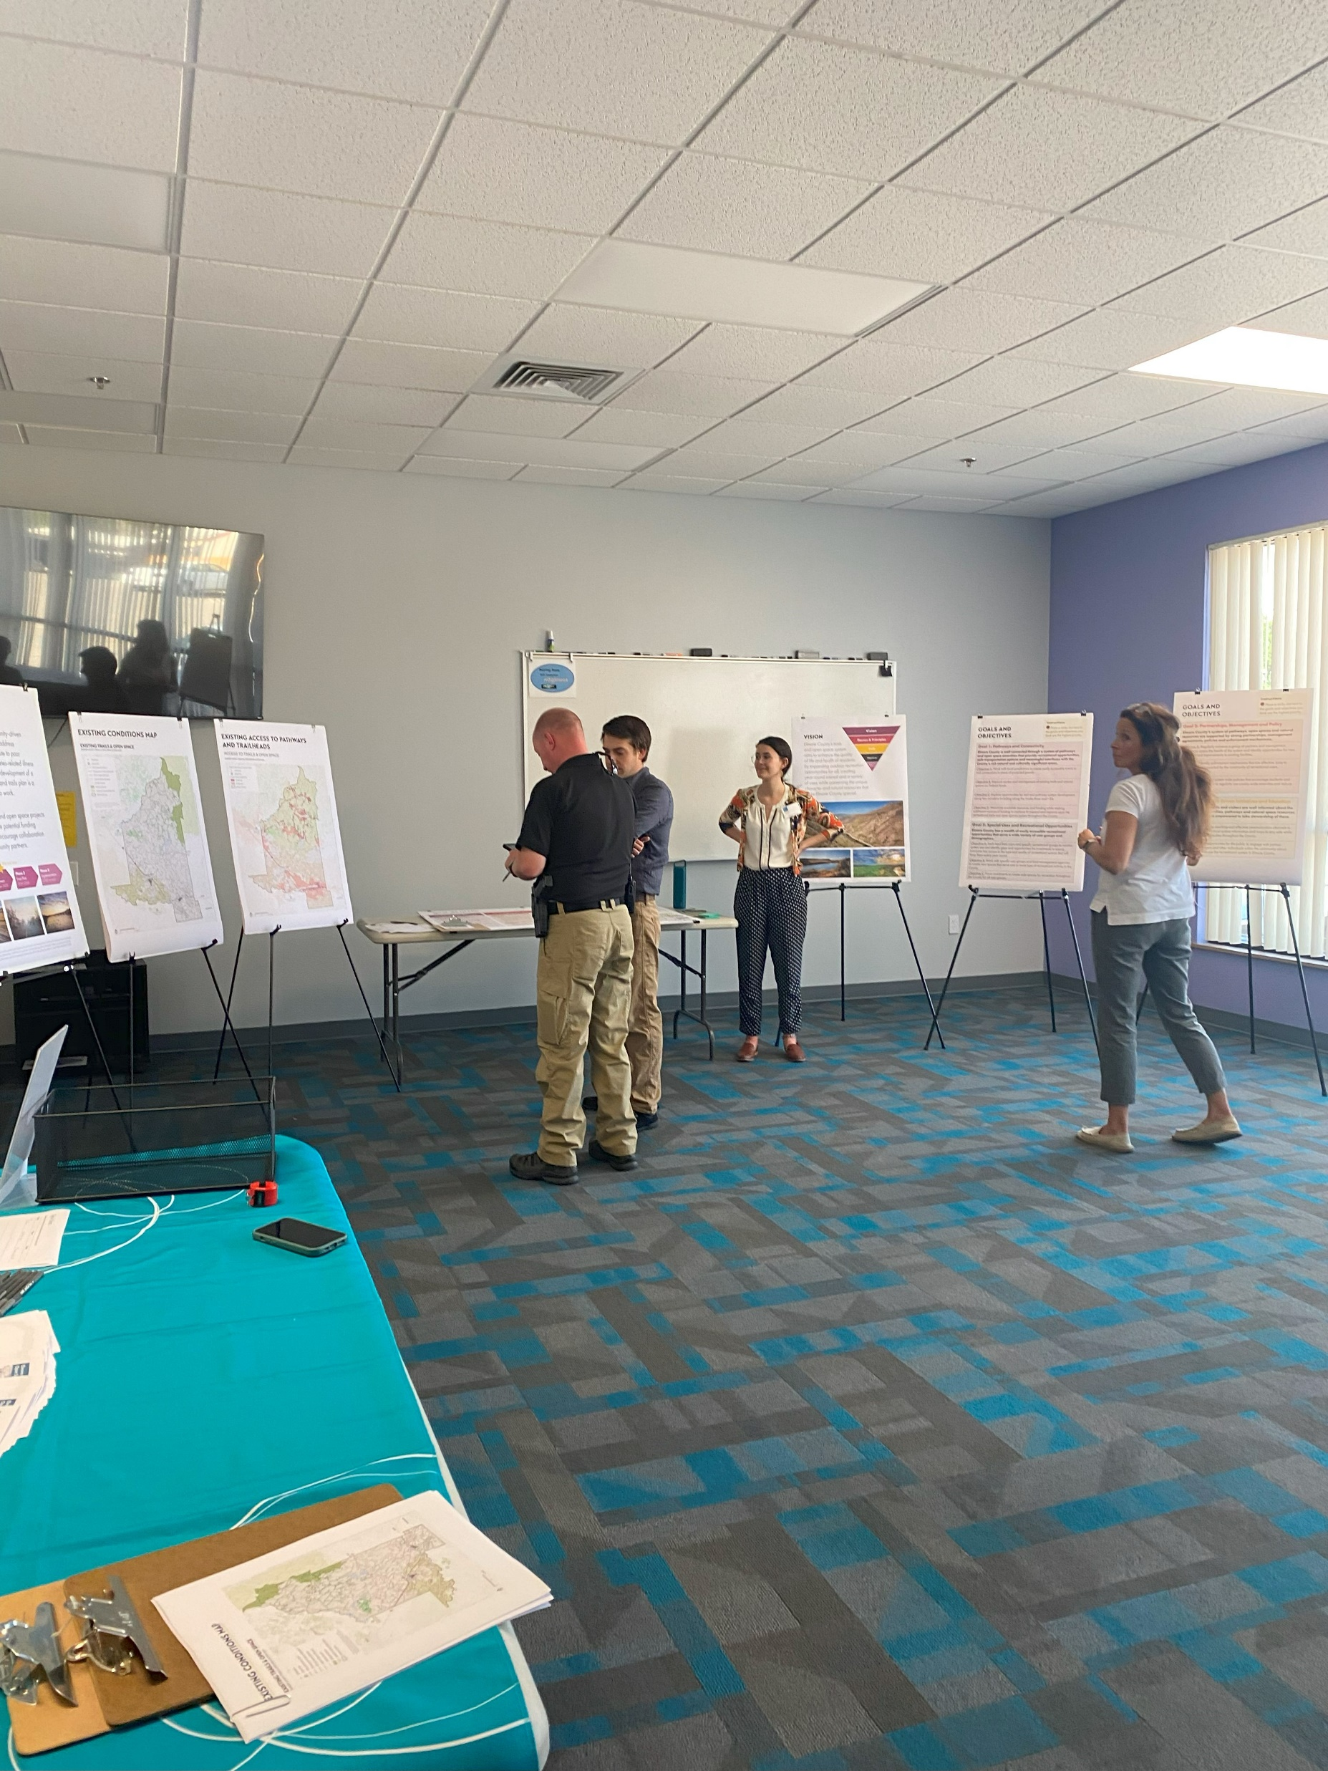
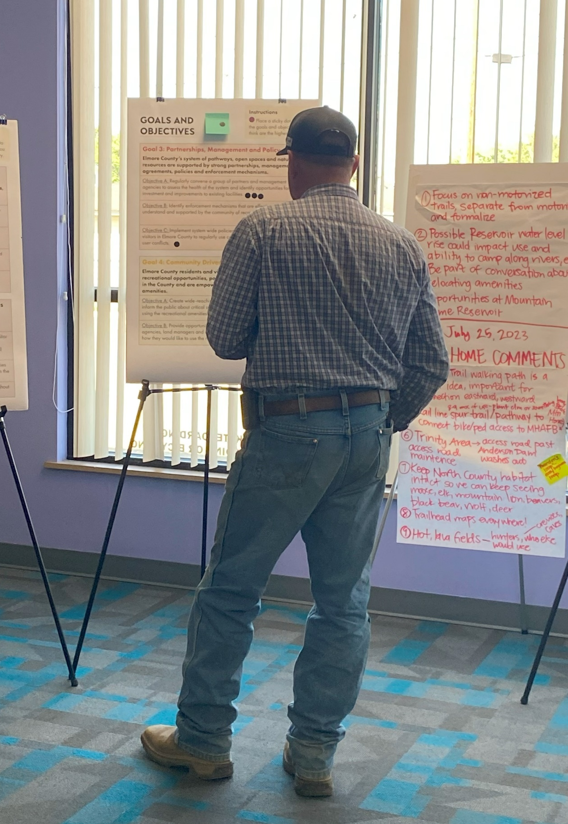
Public Engagement

Slide 12
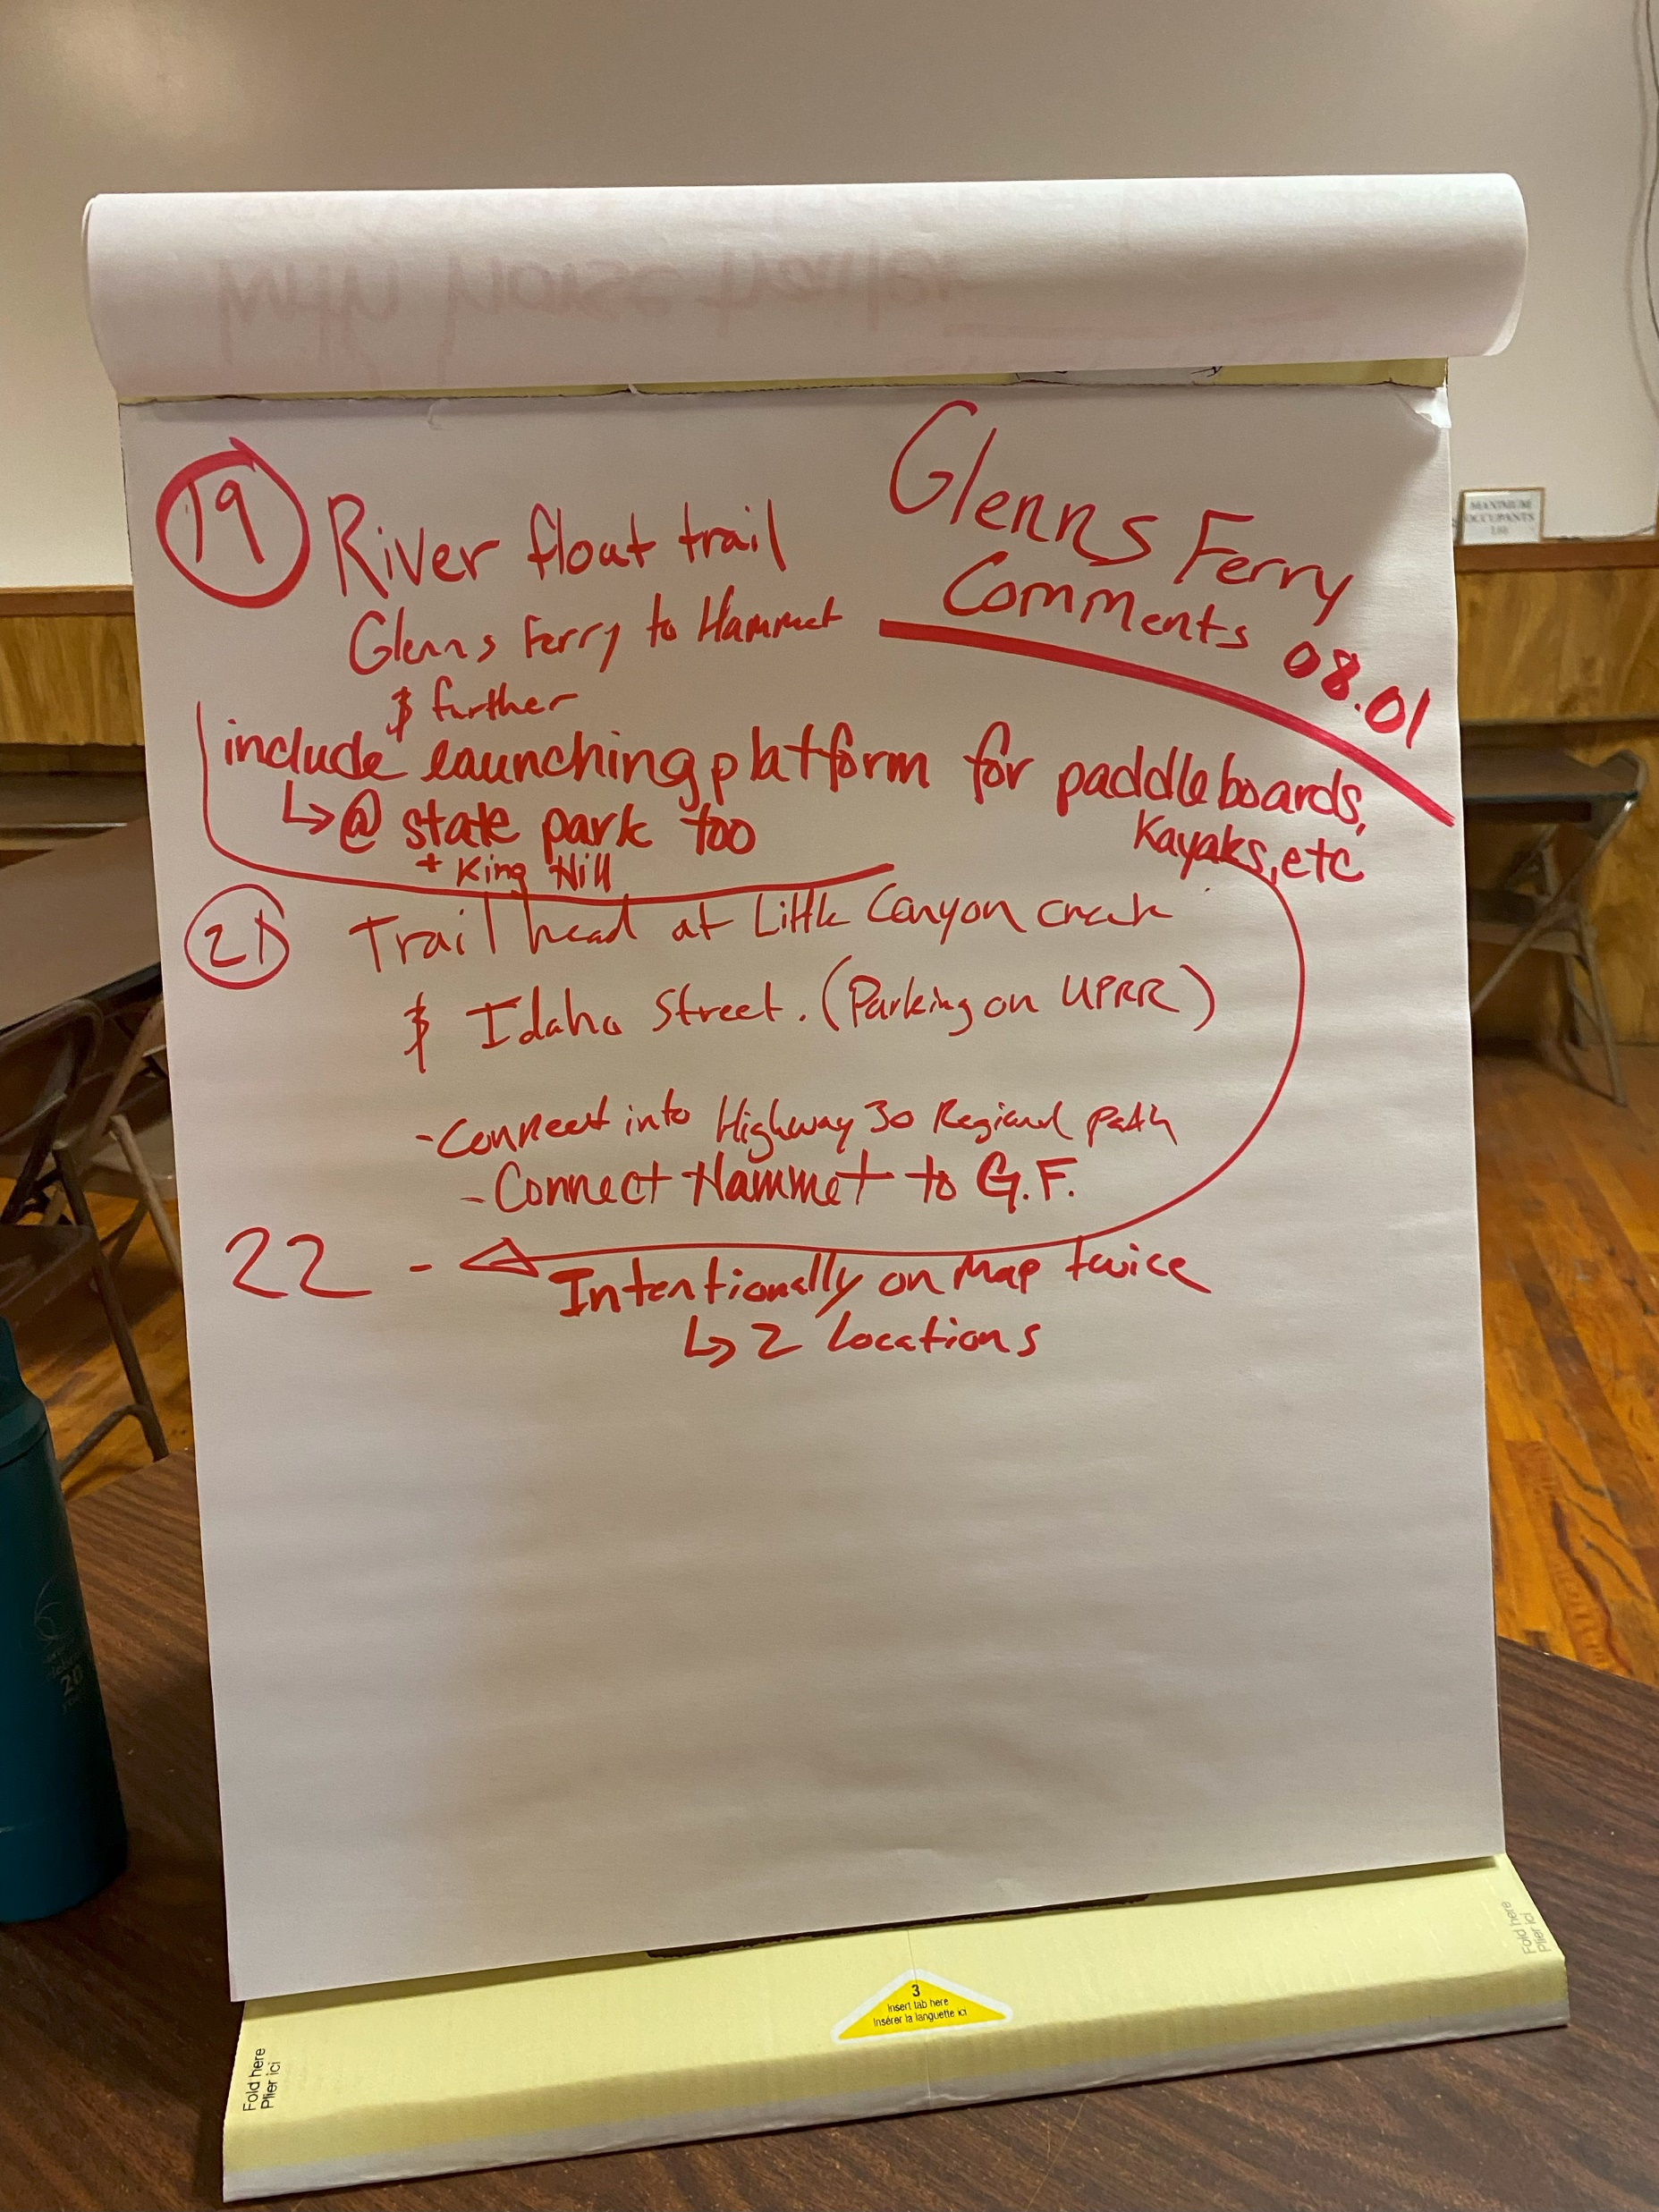
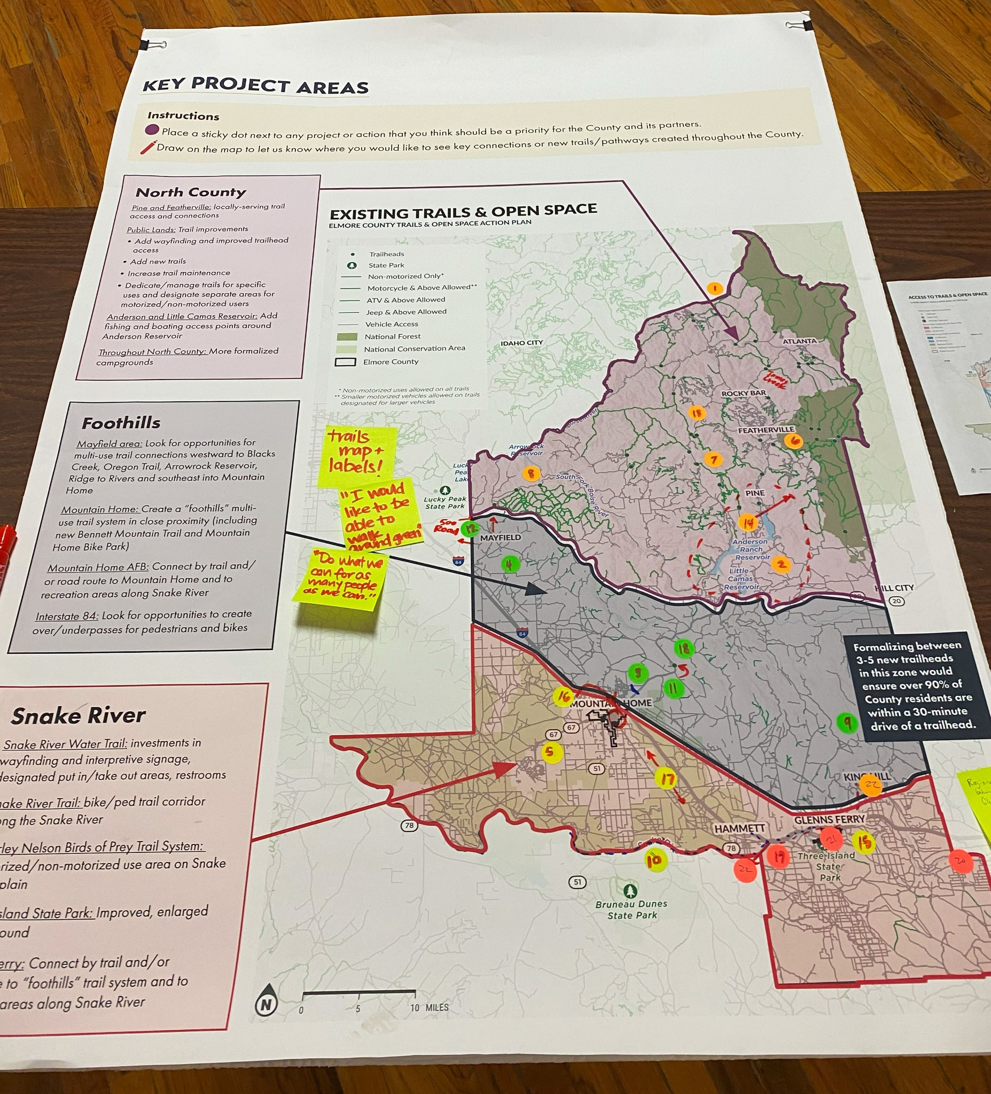
Public Engagement

Slide 13
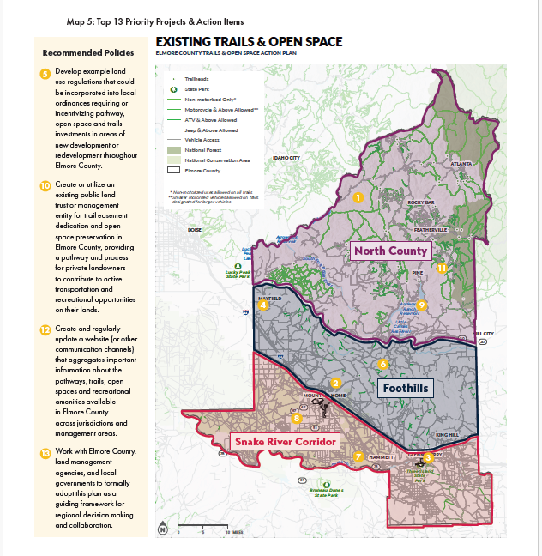
Top 13 Priority Projects & Action Items
Top 13 represent the highest priority actions
Identified for several reasons, including potential impact, feasibility, and public/stakeholder support

Slide 14
Implementation Steps

Slide 15
Pathways, Trails and Open Spaces Next Steps
Phase 3: Implementation
Work with Agnew::Beck to prioritize projects based on achievability and feasibility.
Present Action Plan to relevant entities, like the Elmore County Commission, Forest Service, BLM, and Cities of Mountain Home and Glenns Ferry to advocate for funding and adoption of projects.
Build relationships as well as create ownership and buy-in to anticipated projects.

Slide 16
Get Healthy Idaho Year 4
Support and connect Elmore County CHW partners
2. Sustain and support CHEMS program
3. Encourage and incentivize increased participation in the Elmore County Regional Mobility Consortium; Provide technical support
4. Implement and advocate for Pathways, Trails, and Open Spaces Action Plan
5. Evaluate Get Healthy Idaho activities

Slide 17
Upcoming: findhelpidaho.org Training

