Slide 1
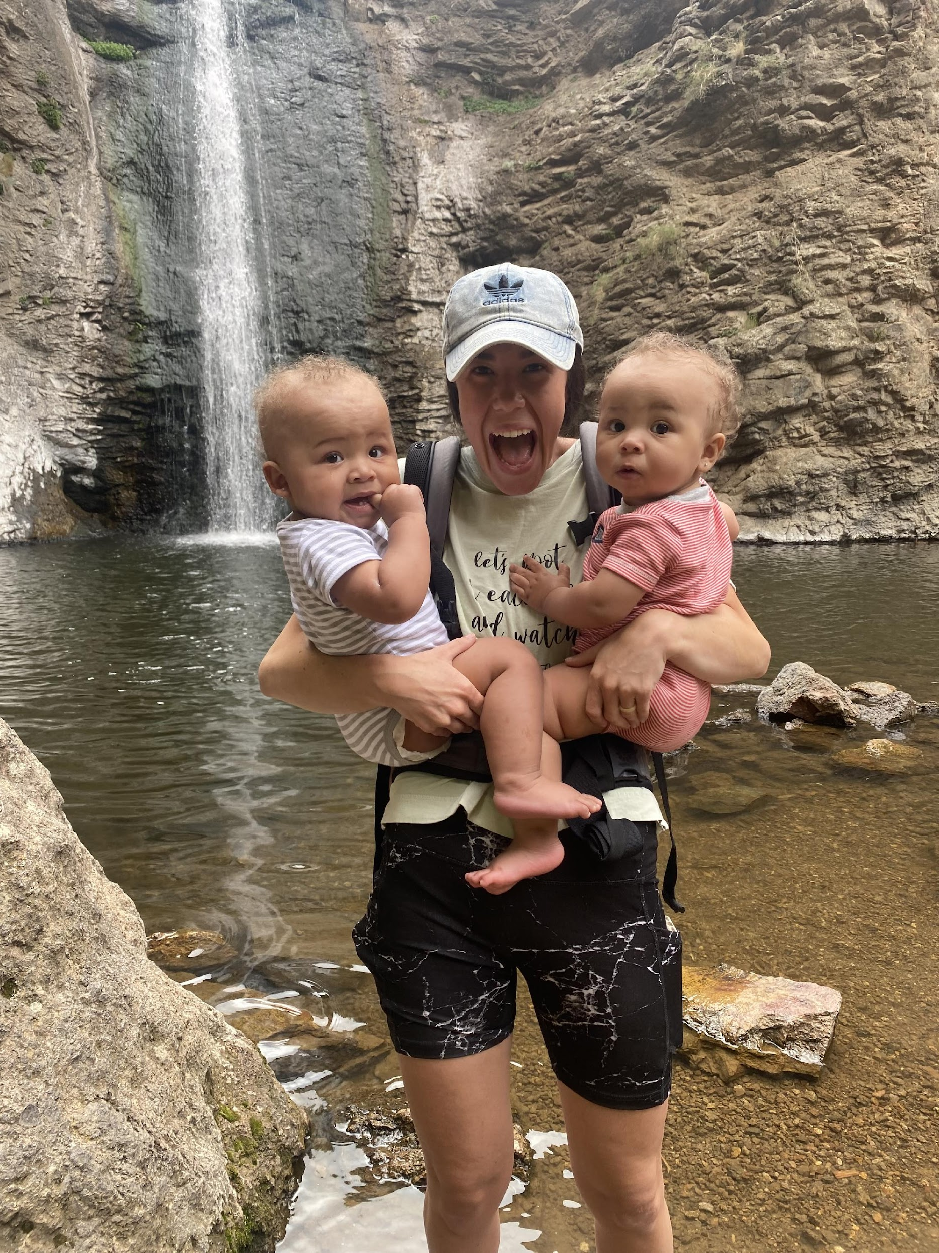
What We DO
We are motivated by faith to keep
children safe and families together.
We host children in volunteer homes and provide a network of support while parents get back on their feet.

Slide 2
Our GOALS
✔ Children Safe
prevent child abuse & deflect from foster care
✔ Parents Supported
strengthen through relationships & resources
✔ Families Together
trauma minimized & hopeful!

Slide 3
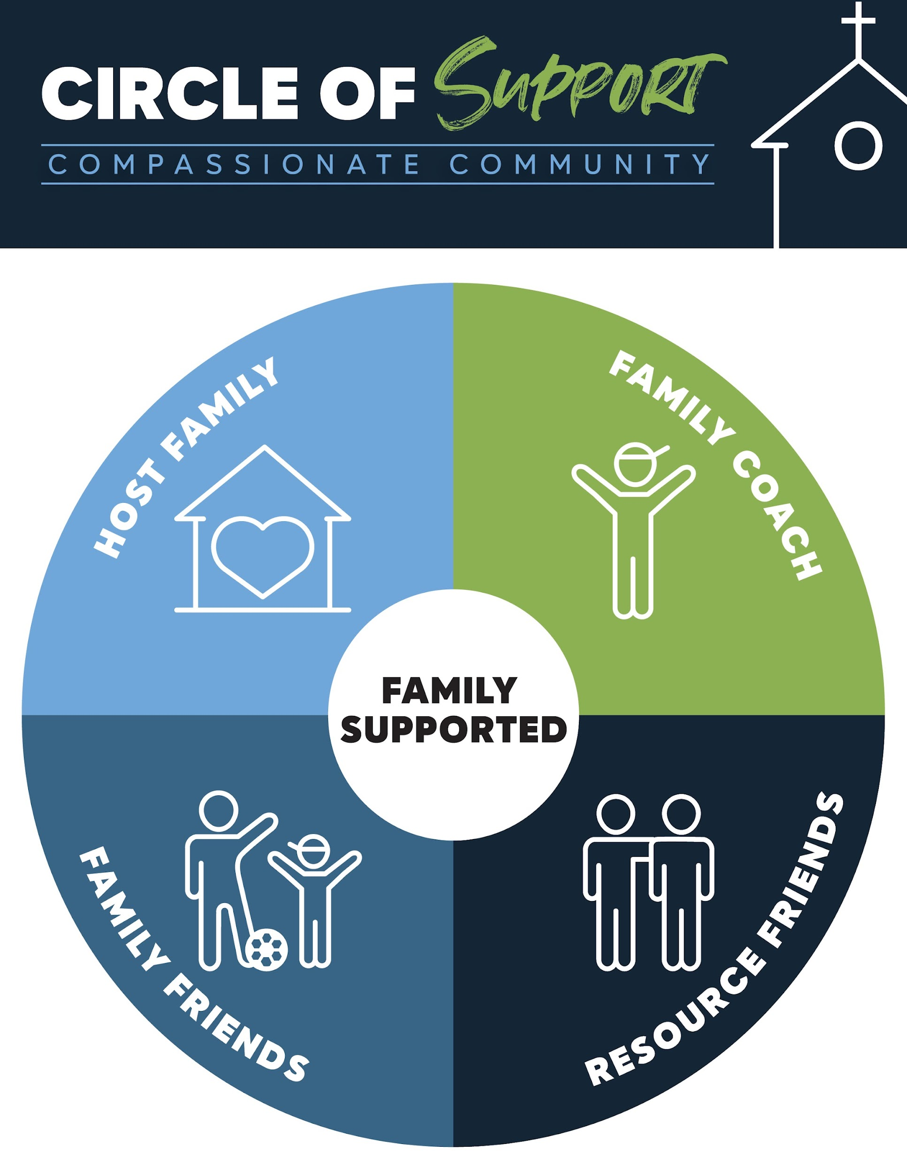
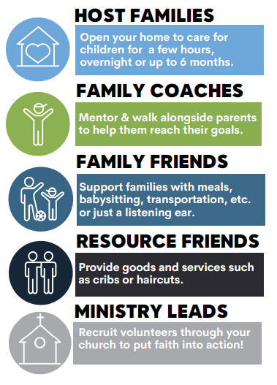

Slide 4
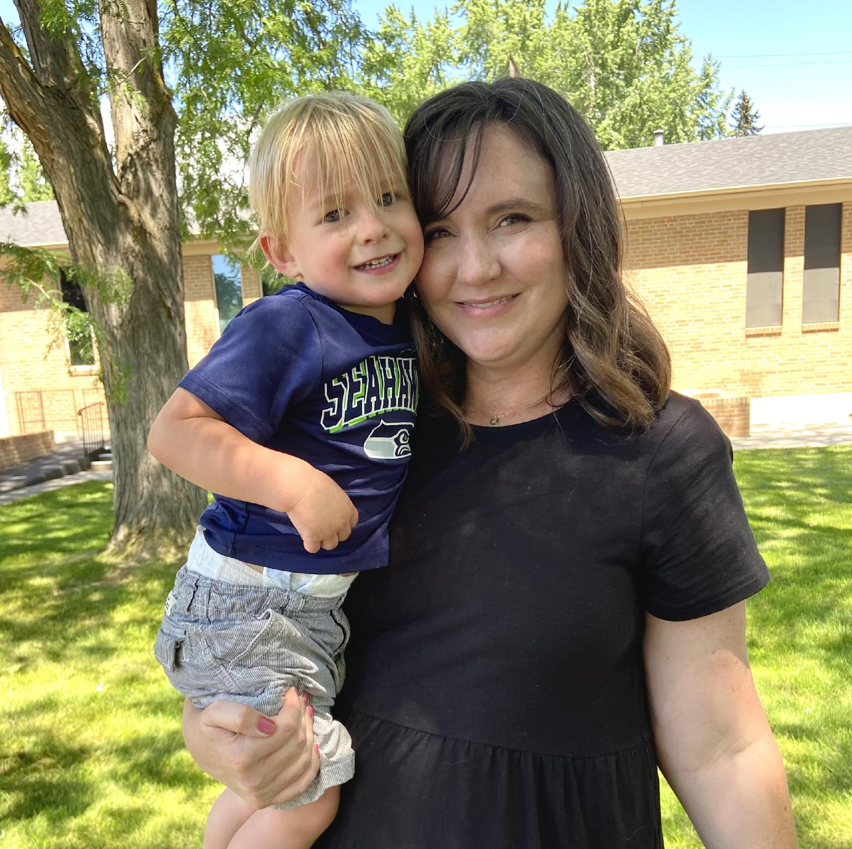
Who we SERVE
Children and families who lack support and are facing a crisis…
Parenting alone
Domestic violence / Substance Use
Hospitalization, medical emergencies, births, etc.
Housing or Job loss / Eviction / Unhoused
What parents need to KNOW
Parents ask for help (or are referred)
We build relationships and all support is free & voluntary
Parents retain full legal custody
Matched with a coach to set goals and find support

Slide 5
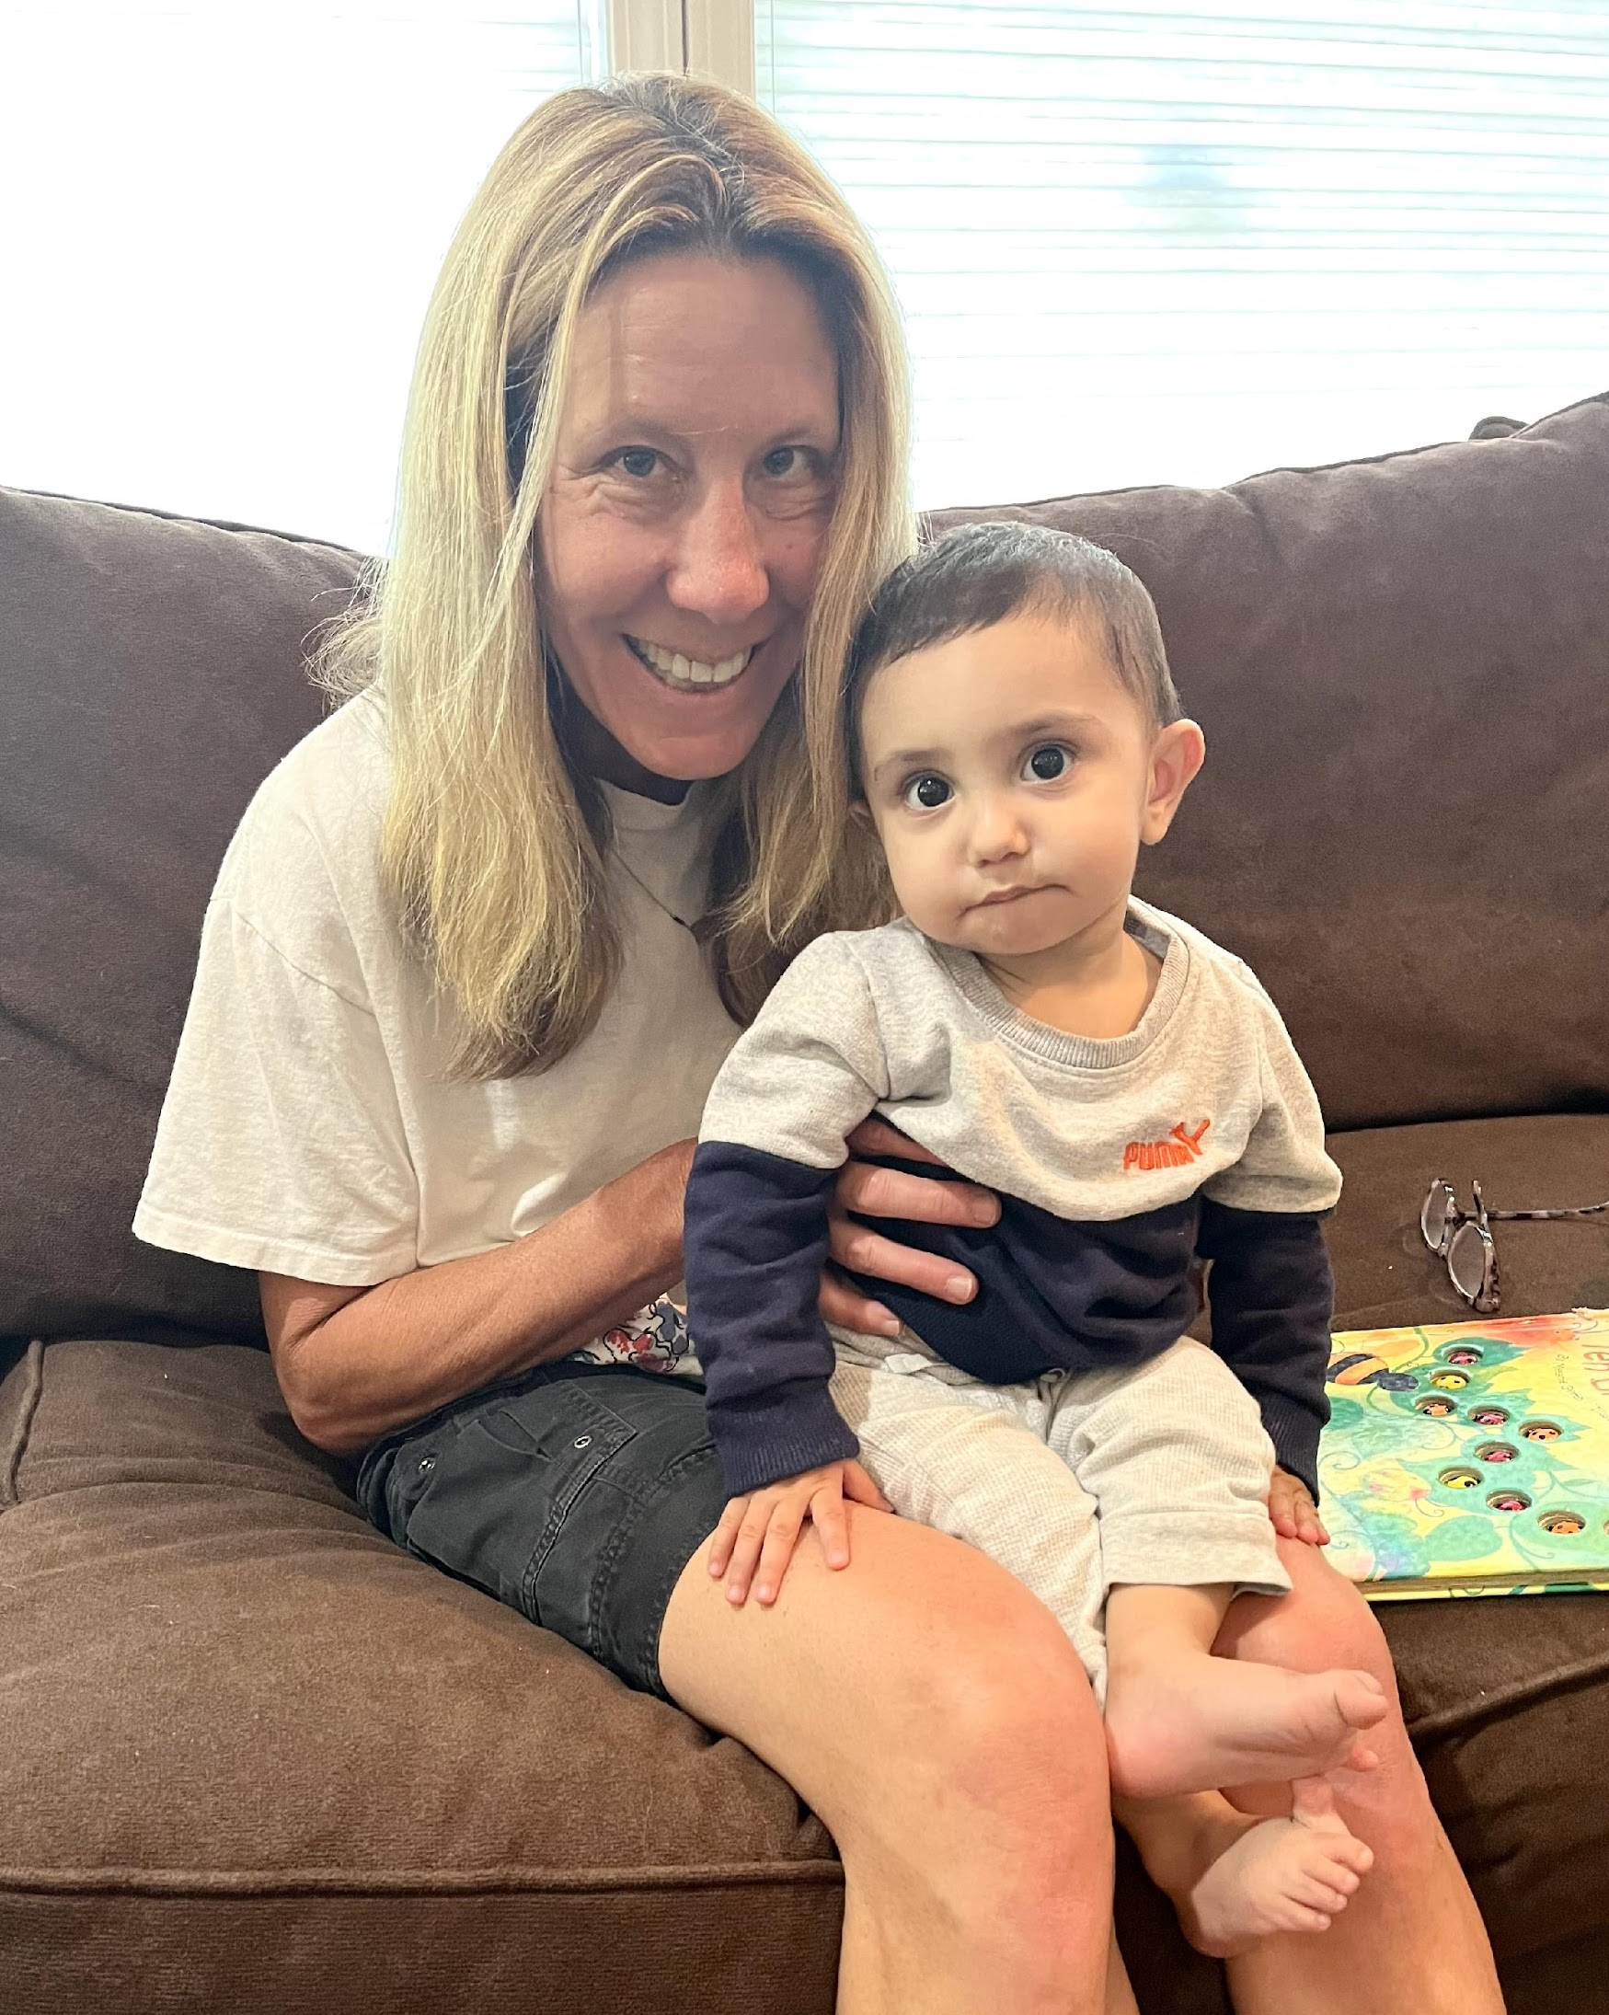
28 Host Families
8 Churches & 156 Volunteers
2023 IMPACT by the numbers
Radical Hospitality
Disruptive Generosity
Intentional Compassion
$17,708
Donated goods & resources
72 Requests for HELP
56 Families & 122 Individuals
Served
100% Families Together
630 Safe Bed Nights + 485 Hours of Respite Care
915 Hours of Parent Coaching

Slide 6
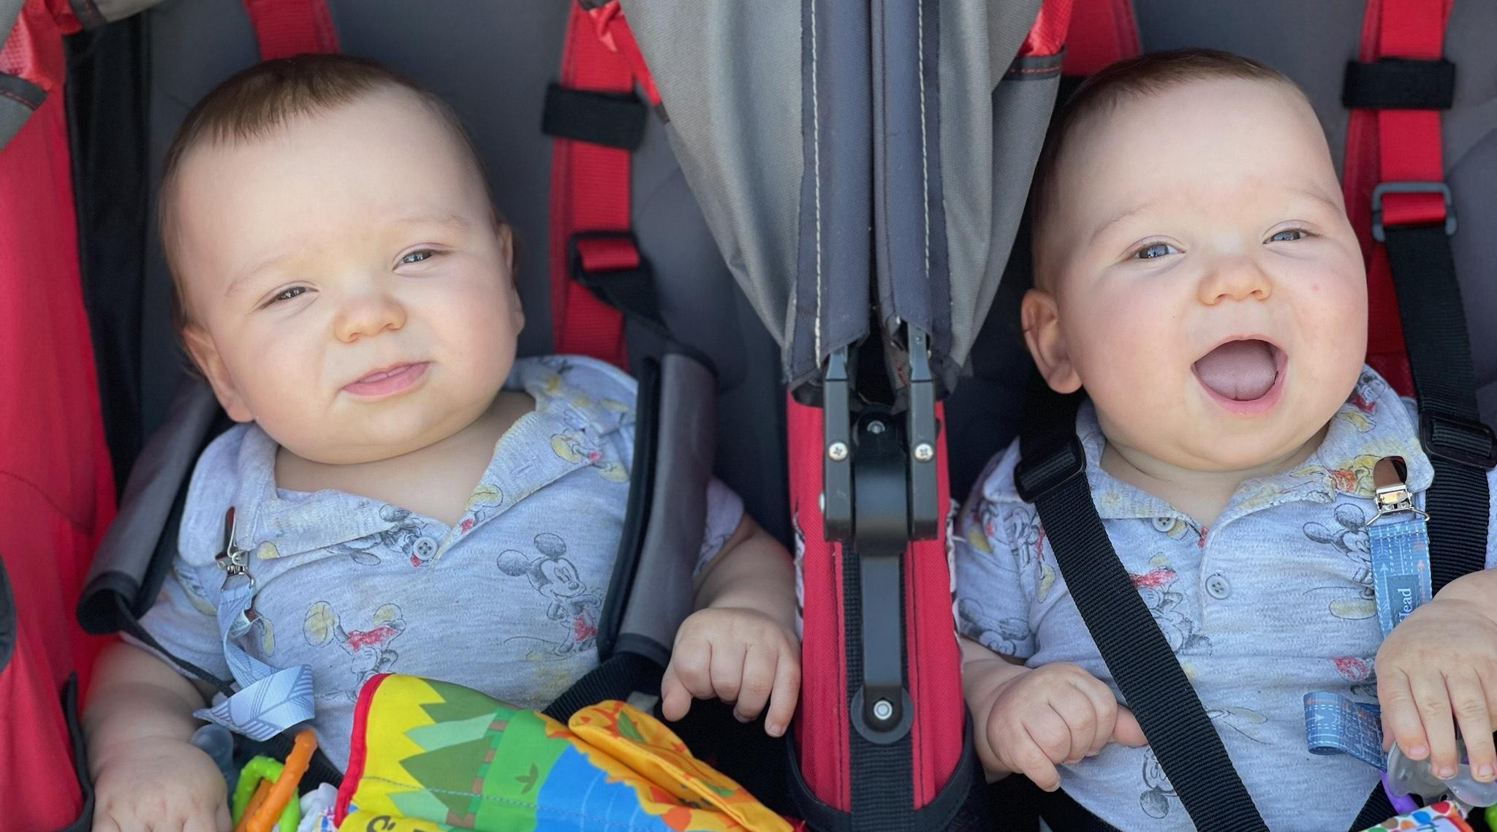
How we can PARTNER
Refer families in need
Share with your church
Volunteer
Donate
Sign up for E-Newsletter
Raise awareness, share resources & network
Other?!

Slide 8
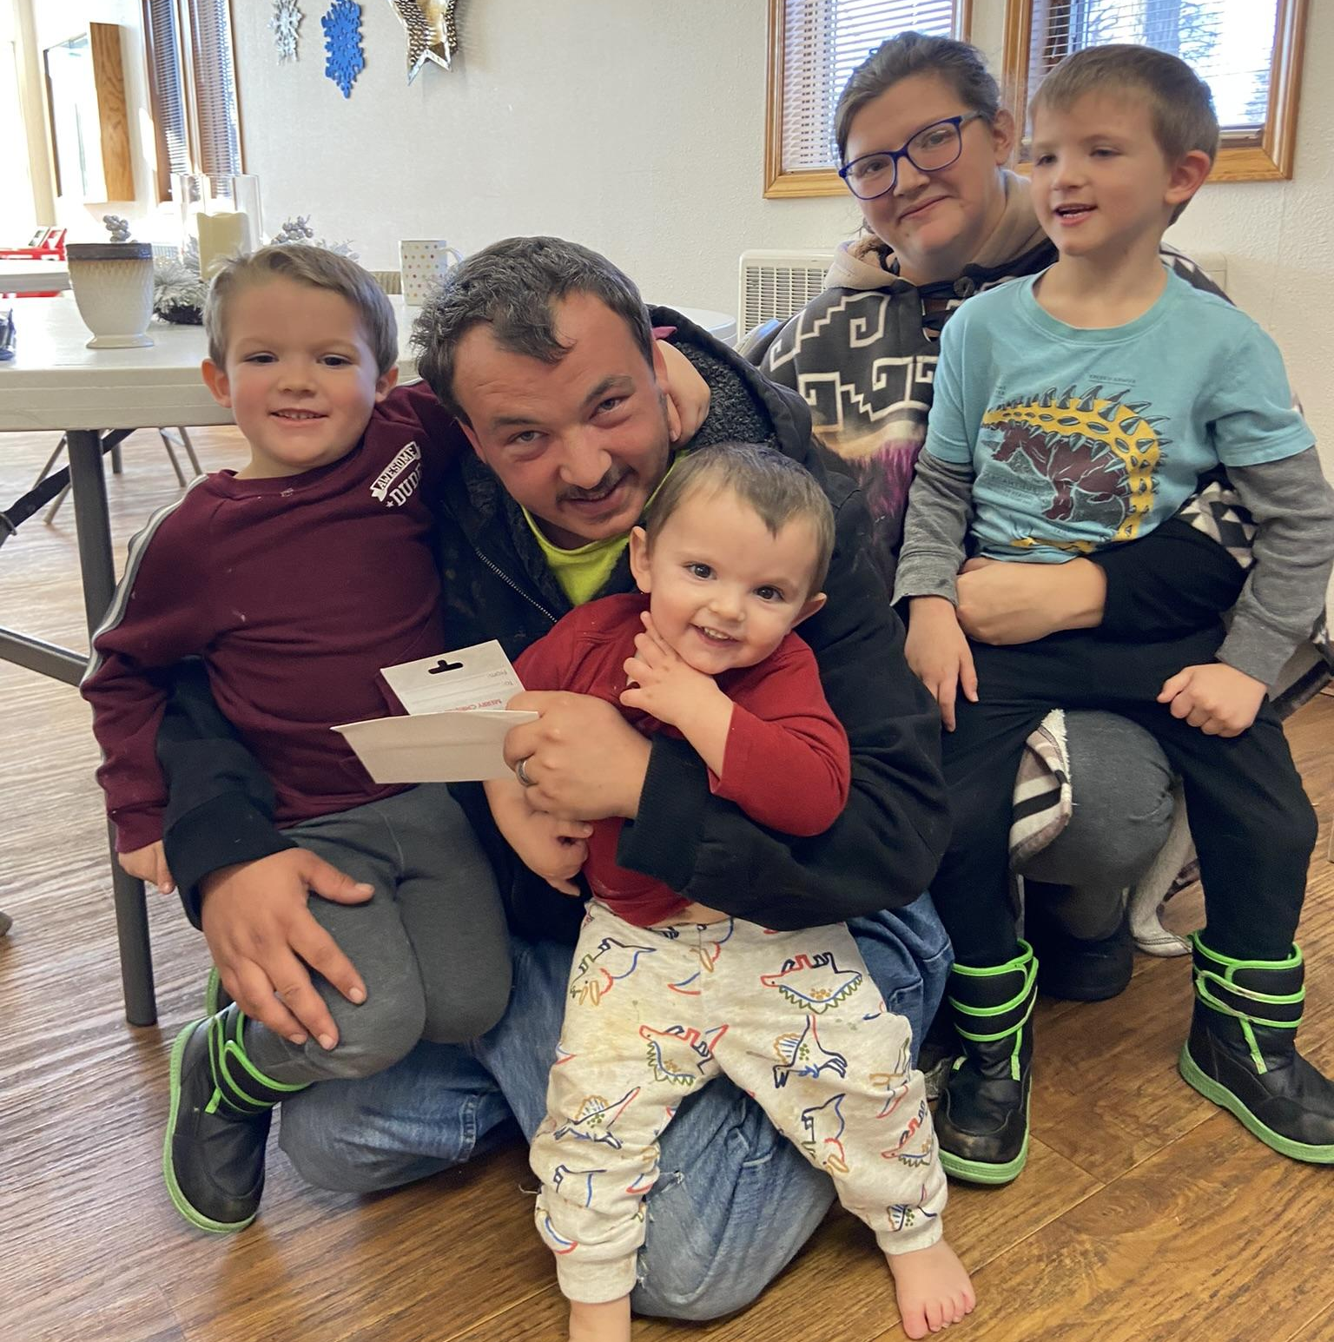
"We just couldn’t do it any more. We had been homeless for 2 years, then we lost our car, and our boys needed more. We didn’t see a way out of the same foster system we had come from. Safe Families saved us. They gave our children a place to stay until we got jobs and got back on our feet. They helped our family stay together. I just don’t know where we’d be without them. They are absolutely the best.”
- Family deflected from foster care

Slide 9
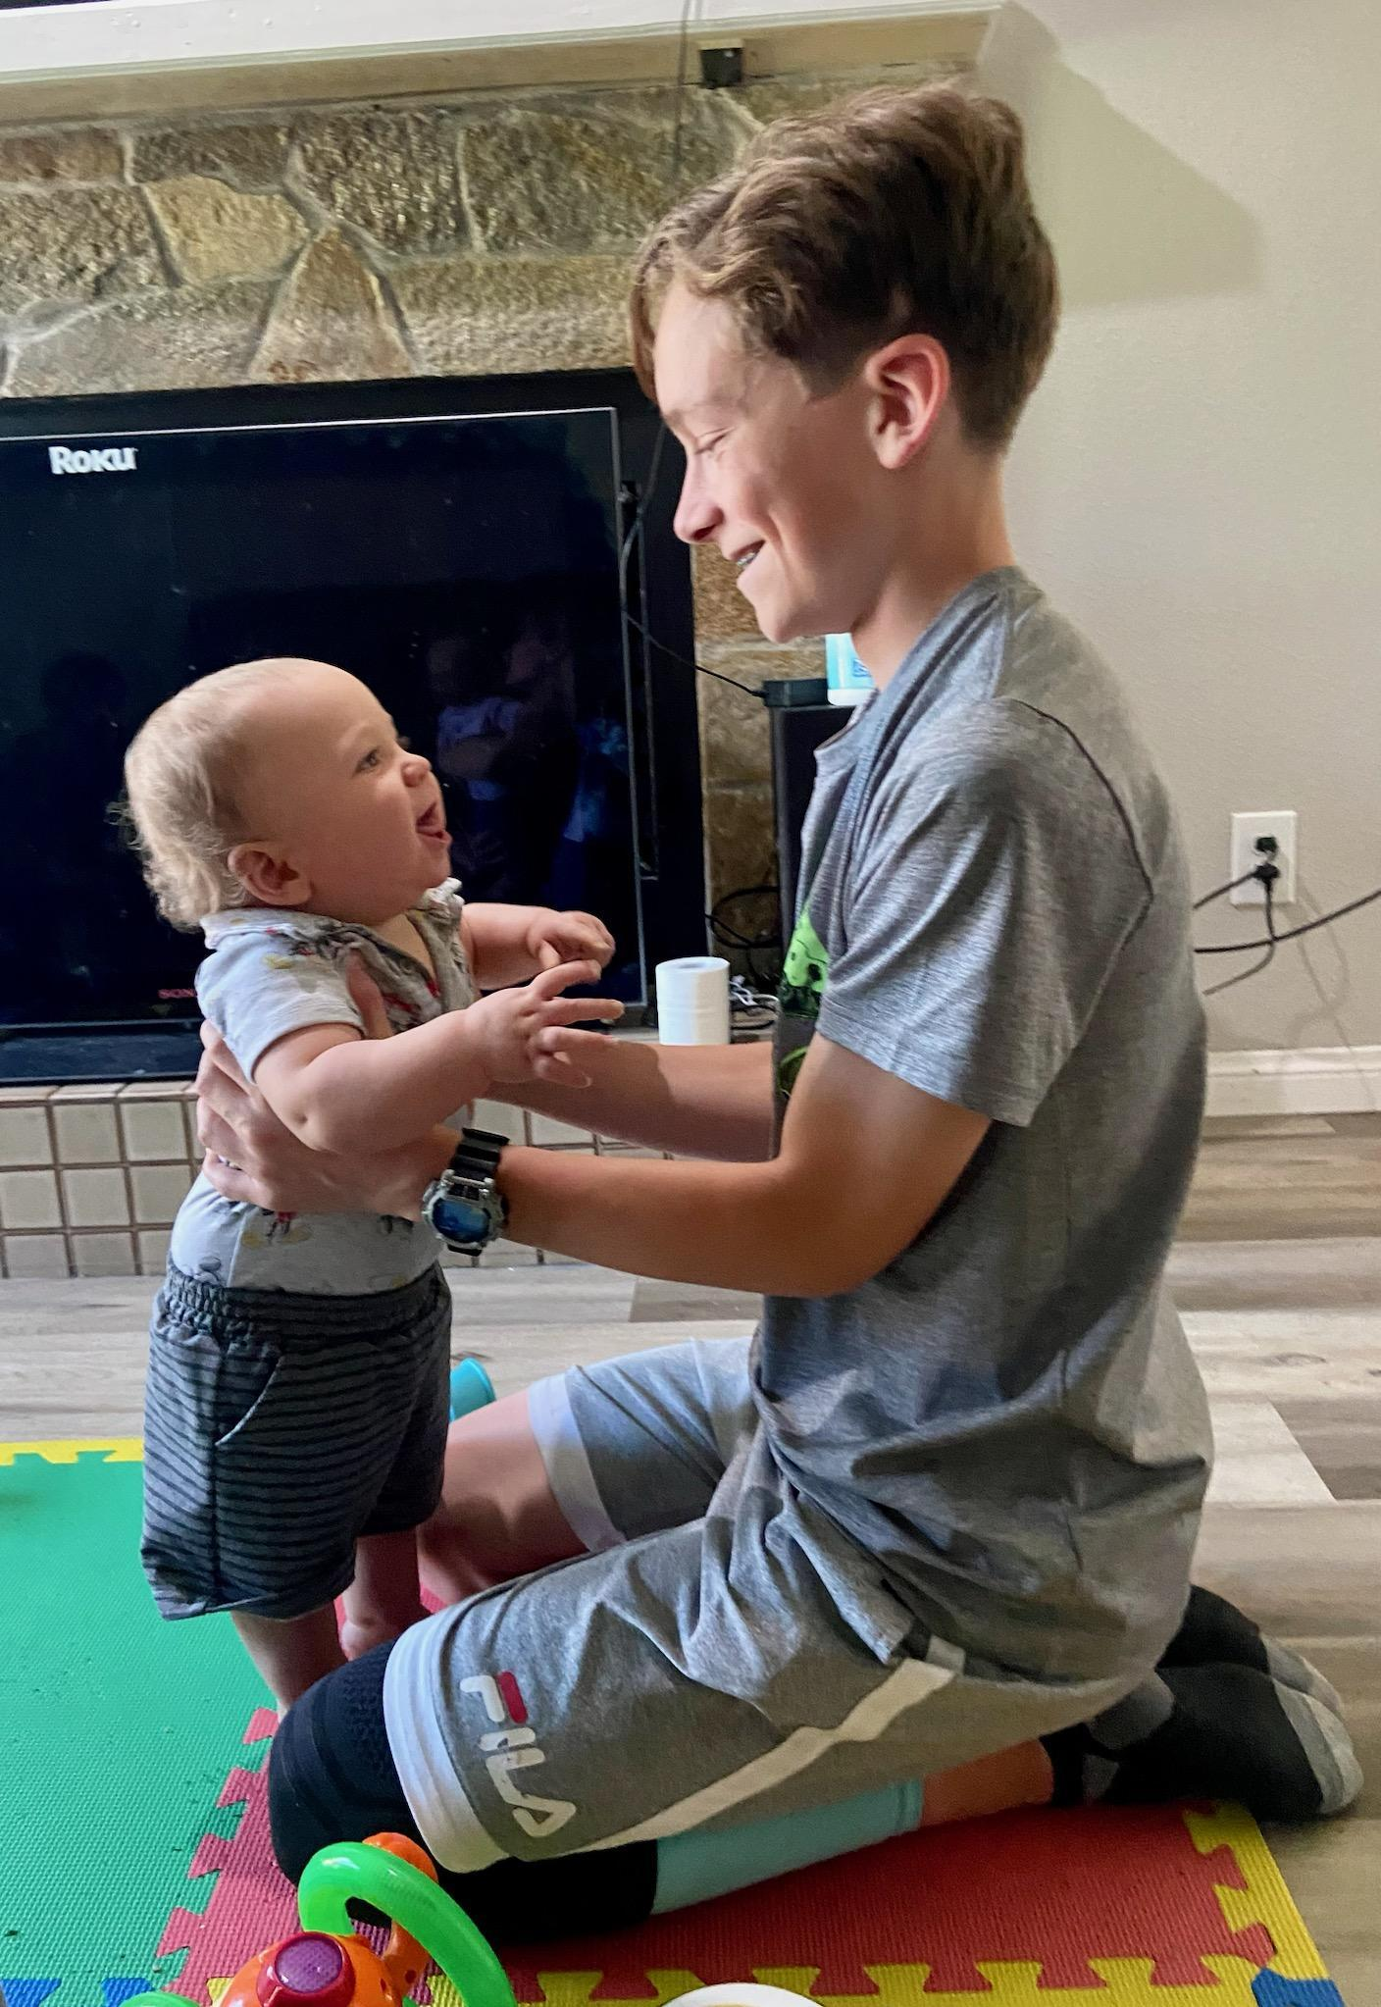
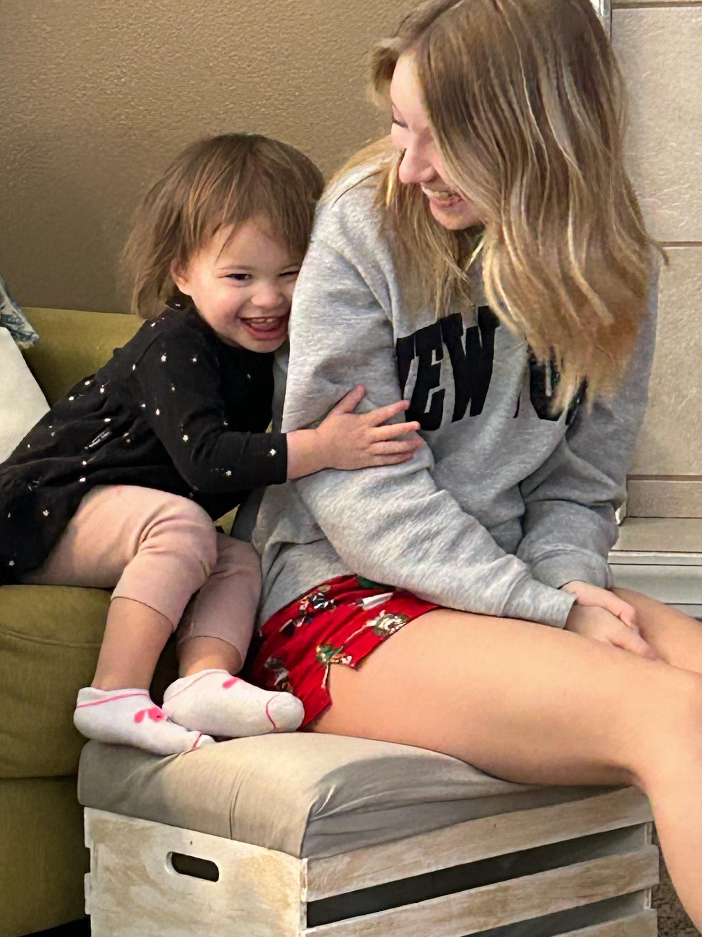
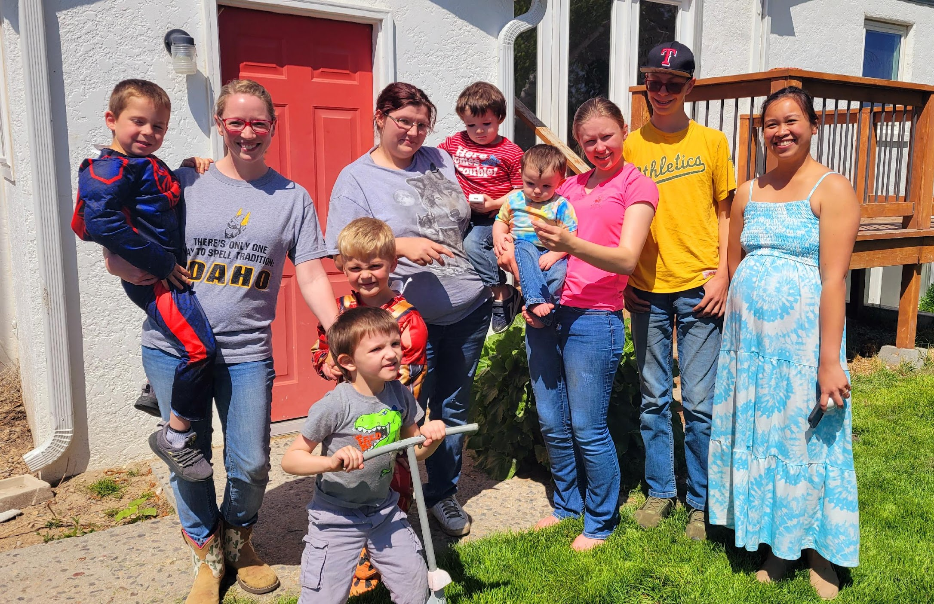
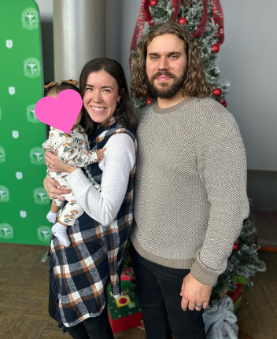
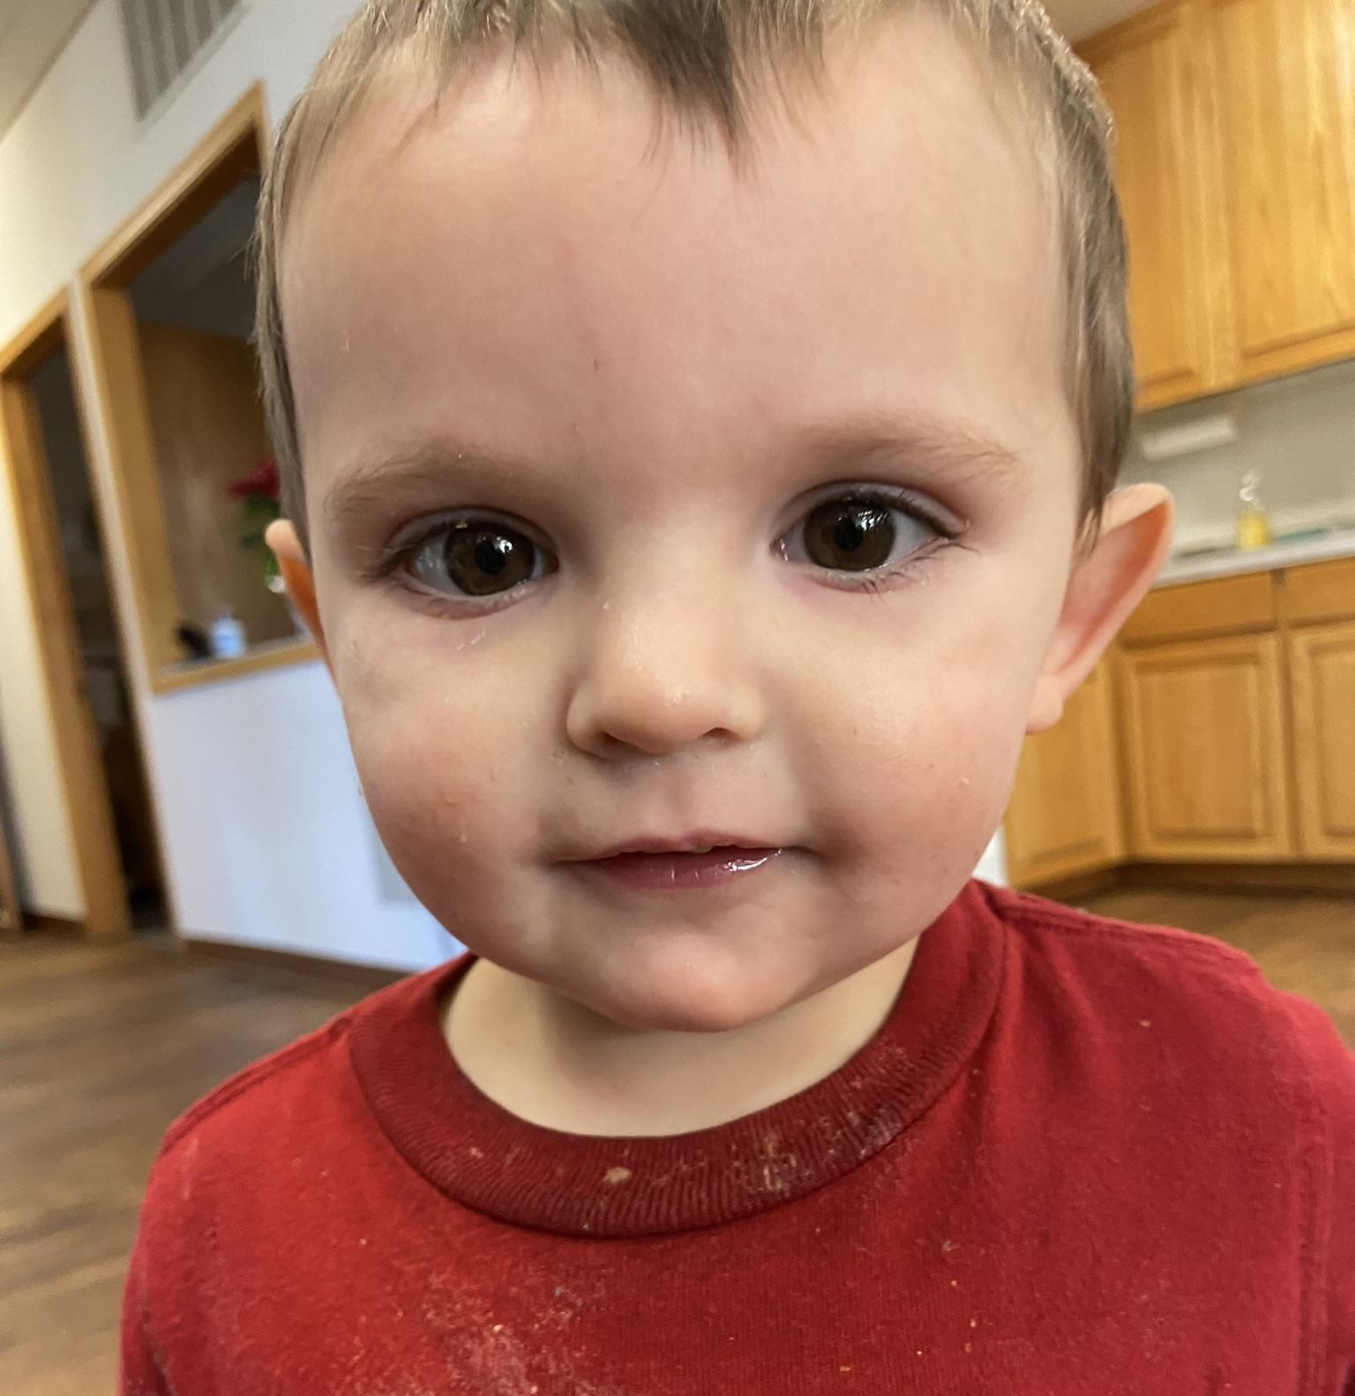
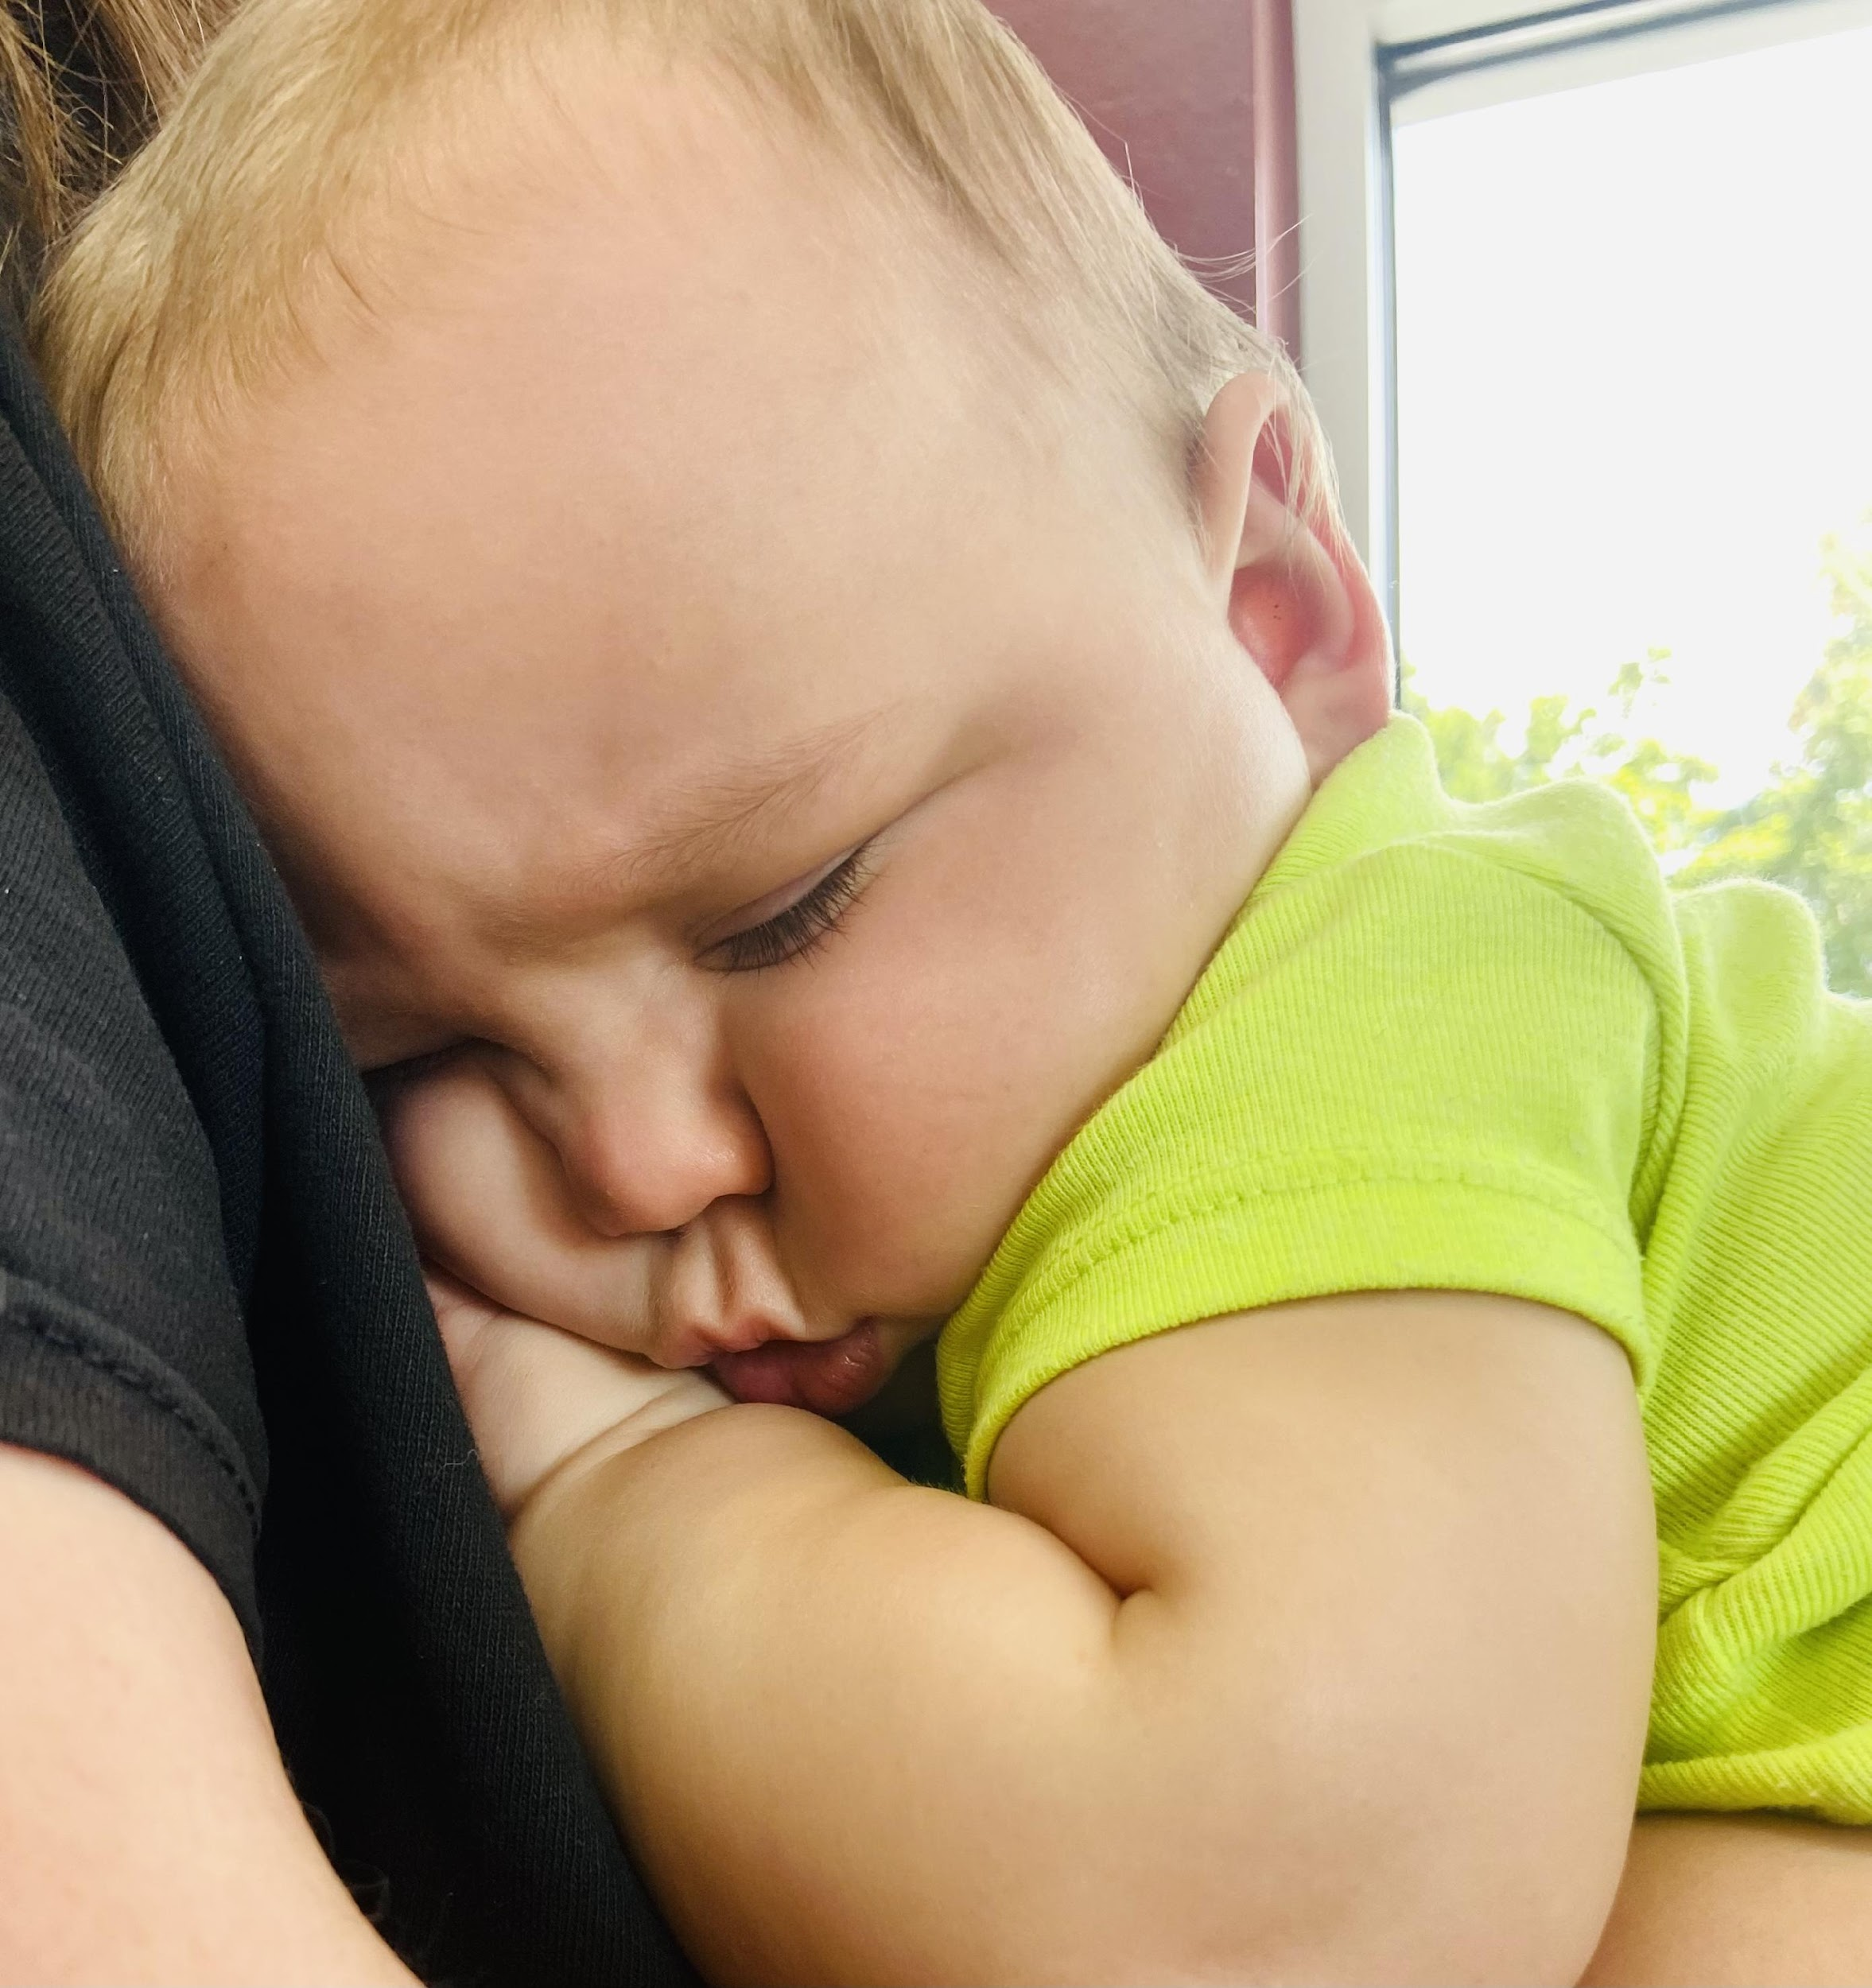
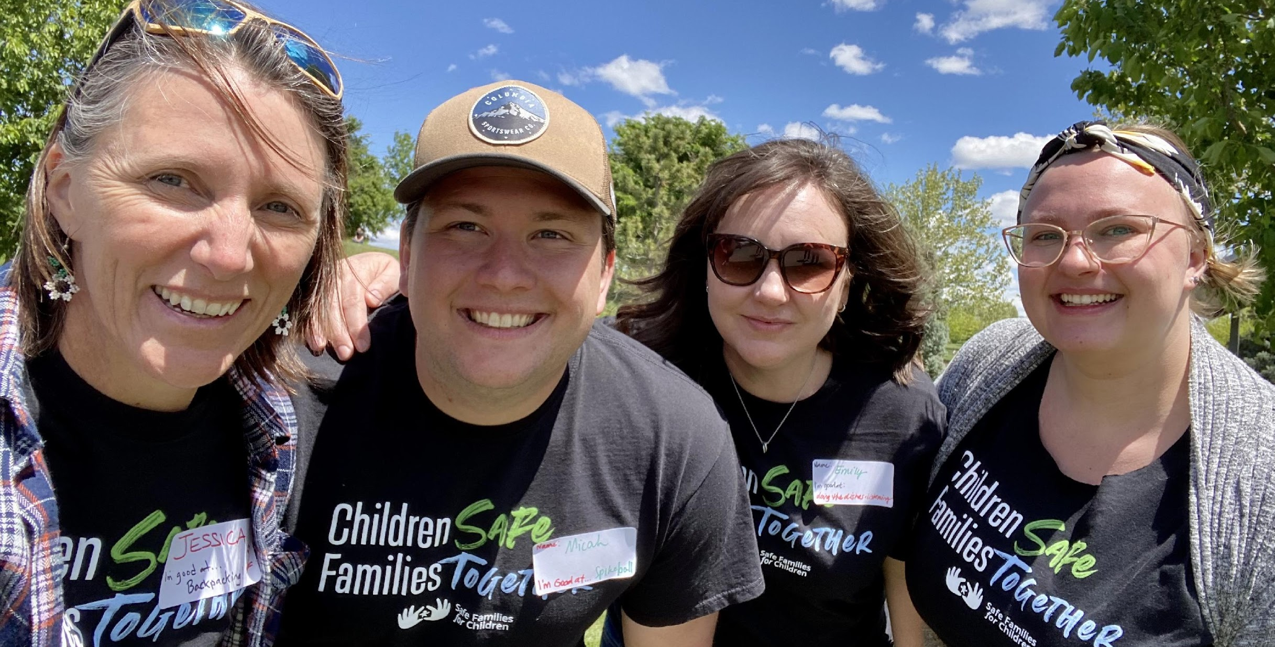
We invite you to join us!

Slide 10
Jessica Ruehrwein, LCSNW District Director
jruehrwein@lcsnw.org
2920 Cassia Street
Boise, ID 83705
208.509.2431
SafeFamiliesTV@lcsnw.org
www.LCSNW.org

Slide 11
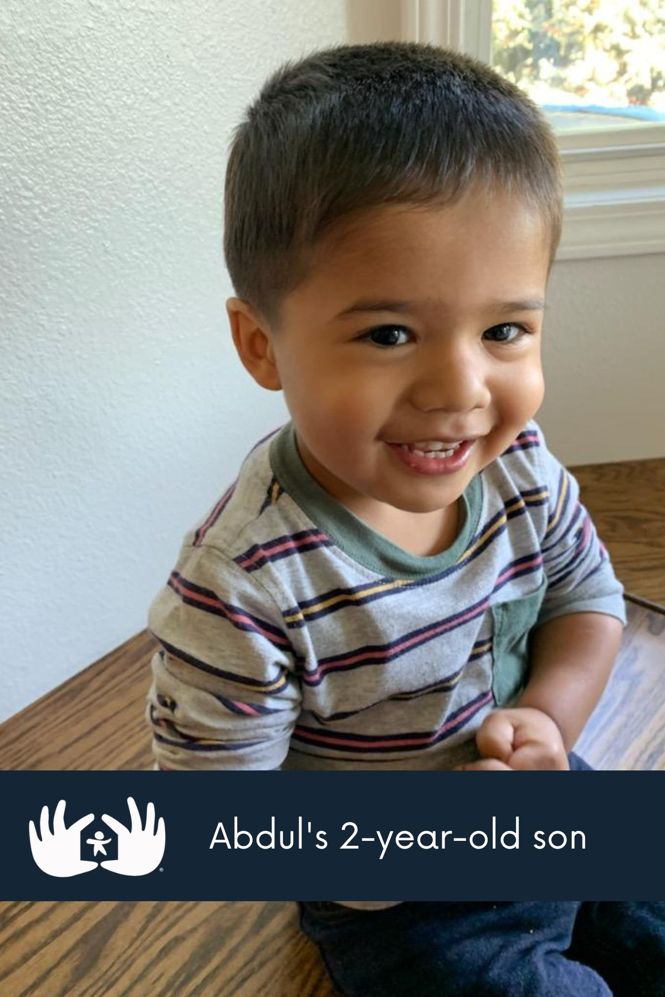
It’s so beautiful to watch your kids reach out to other kids. The kids that we had just loved us and they were excited to be with us -- but they adored our children. Our kids gave up their bedroom, their toys and they bunked with each other to make room. And they didn’t just give up some of their toys – like the discarded toys – they gave them their best toys. It truly was a family ministry for us. You don’t have to host kiddos in your home – there are so many things you can do with Safe Families!
Jennifer, Nampa Host Family

